Slide 1

OnPoint Financial Literacy Education
Lesson 10: Paying Taxes
Notes:
Distribute the handout packets to students, if you have not already.

Slide 2
Warm-up
Think about the last time you visited a national, state or local park.
Who pays to keep the park clean and maintained?
Notes:
Think about the last time you visited a national, state or local park.
Who pays to keep the park clean and maintained?

Slide 3
What taxes are used for
Government | How Taxes are Used
Federal | Pay for services that support the entire country, like national defense, Social Security, highways and large government programs
State | Pay for services within a state, such as public schools, state roads and health programs
Local (city, county) | Pay for everyday services in your community, like parks and police and fire departments
Notes:
Review with students the information provided.
Explain that paying taxes is a responsibility of people who live and work in a community. Taxes are collected by governments to pay for things we all use, like schools, roads, parks and emergency services. When everyone contributes, communities can provide these shared services.

Slide 4
Learning targets
I can:
Explain the basic tax filing process, from earning income to filing a tax return using forms like a W-2, 1040, and 1099
Describe how taxes affect my take-home pay and how different types of income can be taxed differently
Explain why governments collect taxes and identify public services that are paid for with tax dollars
Notes:
Point students to the copy of the learning targets provided on the first page of their handouts. Review the learning targets with them.
Point students to the copy of the lesson glossary provided on the first page of their handouts and review the terms with them.
Point students to the Note Catcher handout and invite them to use it to take notes during the lesson.

Slide 5

Presentation

Slide 6
Tax process
Earn money
Taxes withheld
Receive tax forms (January)
File tax return (April 15)
Refund or amount owed
e.g., W-2, 1099
Notes:
Review with students the process by which money is earned and taxes are paid in the U.S.
Explain that paying taxes is required by law, which means people who earn enough money must report their income and pay the taxes they owe to the government.
Highlight that April 15 is Tax Day, which means people must send in their tax forms by that date and either pay any taxes they still owe or show that they should get a refund.

Slide 7
Taxable income
How you earn money affects how taxes are handled
  Job income: Taxes are usually withheld automatically
  Freelance or side jobs: Taxes are often NOT withheld
  Savings and investments: May be taxed later
Notes:
Review with students the types of income subject to taxation.
Remind students of the difference between earned (active) income and unearned (passive) income they learned about in Lesson 2, Managing Your Money. Job income and income earned from freelance or side jobs are earned income, while income from savings and investments are generally unearned income.

Slide 8
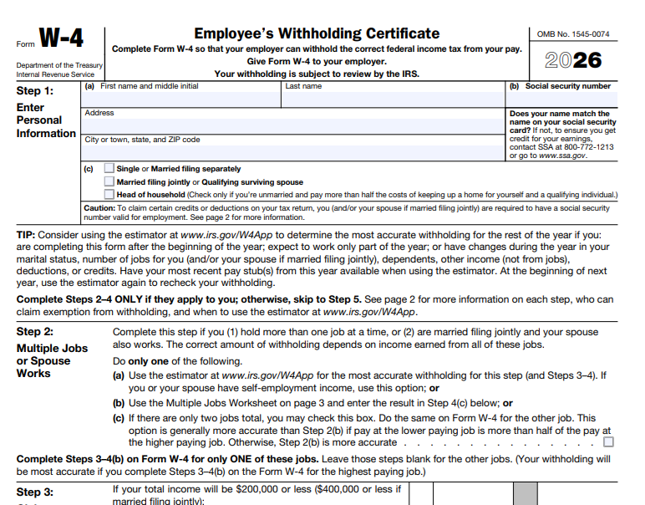
Common tax forms: W-4 (Employee’s Withholding Certificate)
A form you fill out when you start a new job
It tells your employer how much federal tax to take out of your paycheck
The information helps make sure the right amount of tax is withheld
You can update your W-4 if your job or personal situation changes
The goal is to avoid owing a lot of money or getting a huge refund at tax time
Image source: Internal Revenue Service
Notes:
Review with students the information provided.
Note that this is one of two forms from the U.S. government students are likely to see if they apply for a job. The other is the I-9, which is discussed on a later slide.

Slide 9
Common tax forms: W-2 (Wage and Tax Statement)
A form your employer gives you at the end of the year
It shows how much money you earned and how much tax was taken out
You use the information on your W-2 to file your taxes
You usually receive your W-2 by January each year
If you worked more than one job, you may get more than one W-2
Notes:
Review with students the information provided.
Highlight that employers send W-2s to employees each January of the year after the money was earned.

Slide 10
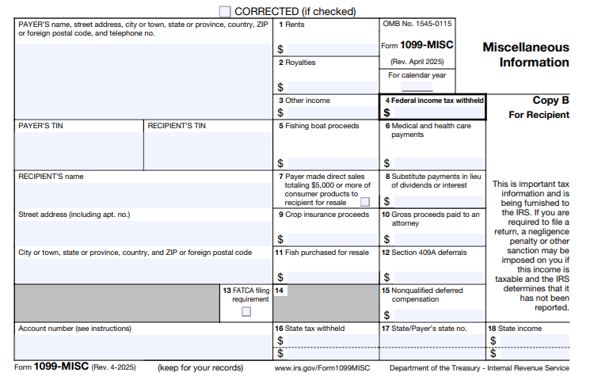
Common tax forms: 1099
A tax form that shows money you earned when you are not a regular employee
It is common for freelance work, gig jobs, or side hustles
No taxes are usually taken out of this money when you are paid
You use a 1099 to report your income when you file your taxes
If you earn from more than one gig, you may get more than one 1099
Image source: Internal Revenue Service
Notes:
Review with students the information provided.
Note that 1099s are usually sent out by the end of January of the year after the money was earned.

Slide 11
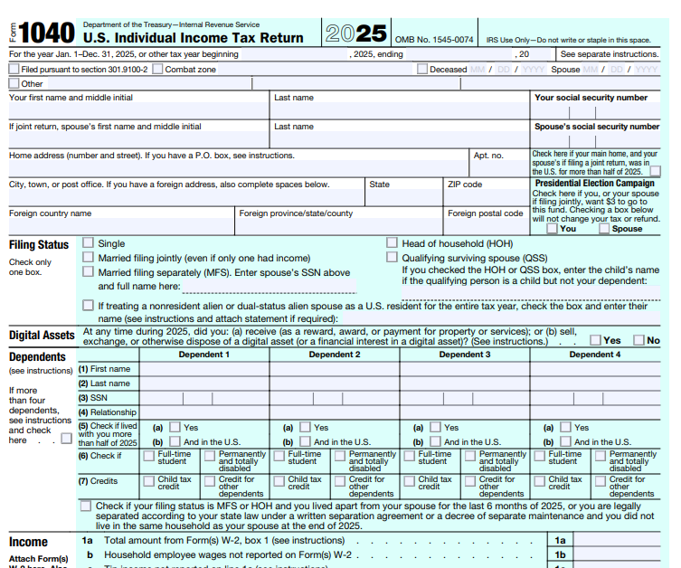
Common tax forms: 1040
The main tax form people use to file their U.S. federal income taxes
It is where you report how much money you earned during the year
You use it to figure out if you get a tax refund or owe money
Information from forms like W‑2s and 1099s goes on the 1040
Even people with simple taxes use Form 1040 today
Image source: Internal Revenue Service
Notes:
Review with students the information provided.
Highlight that this form is used by people with both simple and complex tax situations.

Slide 12
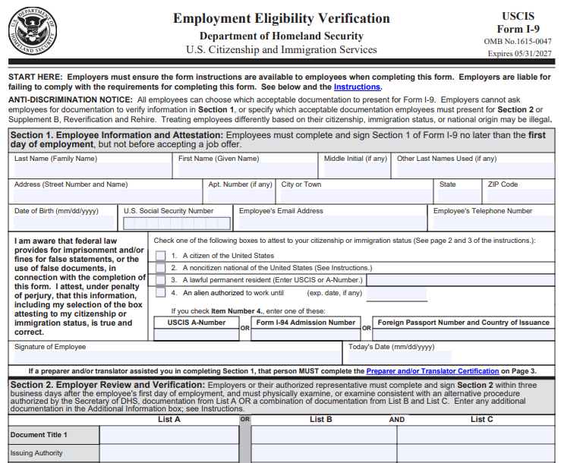
One more form: I-9
Another form you fill out when you start a new job
It proves that you are allowed to work in the U.S
You must show identity documents, like a passport or a driver’s license and Social Security card
Your employer checks your documents and keeps the form on file
The I‑9 is not about taxes or pay—it is only about work eligibility
Image source: Internal Revenue Service
Notes:
Review with students the information provided.
Note that this form is not about taxes or pay, but it is a form students will likely see when they apply for a job.
Employers will typically ask job applicants to complete a W-4 and an I-9 at the same time because they need information from both forms to report to the U.S. government.

Slide 13
Tax deductions and tax credits reduce taxes
A tax deduction lowers the amount of money the government taxes you on
  Example: If you earn $20,000 and have a $2,000 deduction, you are taxed on $18,000
Tax credits lower the actual amount of tax you owe
  Example: If you owe $500 in taxes and get a $300 credit, you now owe $200
There are many deductions and credits; seek help from trusted sources
Notes:
Review with students the information provided.
Emphasize that there are many deductions and credits and that students can seek additional information on them from trusted sources that will be provided on the next slide.

Slide 14
How to get help with taxes
Taxes can be confusing, and it’s okay to ask for help
Free help is available through programs like IRS Free File and community tax clinics
Many schools, libraries, and community centers offer free tax help events
Online tax software can guide you step‑by‑step if your taxes are simple
A trusted adult, like a parent or guardian, can also help you get started
Notes:
Review with students the information provided. Reassure students that taxes are a complex topic and even adults need assistance with taxes.
Transition to the next activity by explaining that students will use their new knowledge to analyze two sample documents they are likely to encounter when they begin working and paying taxes.
Take any questions from students before moving on.

Slide 15

Break
Notes:
Optional break.

Slide 16

Application Activity
Notes:
Divide the class into small groups.

Slide 17
Activity instructions
Work with your group to review the sample pay stub and the notes provided
Answer the pay stub questions
Review the sample W-2 form and the notes provided
Answer the W-2 questions
Be prepared to discuss your answers with the class.

Slide 18

Debrief
Notes:
Using the Reading a pay stub answer key slide (Slide 19), have students compare their work with the answers provided on the slides. If students have questions about or disagree with any of the suggested answers, encourage them to explain their reasoning.
Using the Reading a W-2 answer key slide (Slide 20), have students compare their work with the answers provided on the slides. If students have questions about or disagree with any of the suggested answers, encourage them to explain their reasoning.

Slide 19
Reading a pay stub answer key
What does the pay period tell you?
c) The group of calendar days covered by the paycheck
Based on the pay stub, what is the employee's gross pay for this pay period?
c) $640.00
How many hours did the employee work during this pay period?
b) 32 hours
What is the total amount of deductions (withholding) taken out of the paycheck this pay period?
d) $144.00
Which of the following taxes cannot be refunded?
d) FICA taxes (Social Security and Medicare)
What is the employee's net take-home pay for this pay period?
b) $496.00

Slide 20
Reading a W-2 answer key
What is the main purpose of a W-2 form?
c) To summarize total earnings and taxes withheld for the year
How much did the employee earn in total wages for the year?
c) $6,400.00
How much federal income tax was withheld during the year?
b) $640.00
In addition to the Oregon income tax, what other state or local income tax is listed on the W-2?
b) Oregon Transit tax
Looking at the W-2, how much Social Security tax was withheld for the year?
c) $396.80
Why does the W-2 include state income and tax information?
b) To report income and taxes paid to the state government.

Slide 21

Wrap-Up

Slide 22
Exit ticket
One thing I learned about the tax filing process is ______.
Taxes affect my take-home pay because ______.
One public service paid for with tax dollars is ______.
Notes:
Point students to the copy of the prompts on the slide that is provided on the last page of their handout packets. Invite students to write their responses to the prompt in their handouts in the spaces provided.

Slide 23

Thank You!
Notes:
Answer any final questions and thank students for their participation.

