Slide 1

OnPoint Financial Literacy Education
Lesson 12: Protecting Your Financial Life
Lesson 12: Protecting Your Financial Life
Lesson 12: Protecting your Financial Life
Notes:
Distribute the handout packets to students, if you have not already.

Slide 2
Warm-up
What are things people do—online or offline—that help keep their money and personal information safe?
Why are these important for financial well-being?
Notes:
Point students to the copy of the prompts on the slide (What are things people do—online or offline—that help keep their money and personal information safe? Why are these important for financial well-being?) that is provided on the first page of their handouts.
Invite students to take a moment to write down their responses to the prompts in the spaces provided in their handouts. Tell them there are no right or wrong answers—they should simply write whatever comes to mind.
Have students turn to a partner to discuss their responses together briefly.
After two minutes, invite a few pairs to share their best ideas with the full group.
Remind students of their work in previous lessons to learn and practice informed financial decision making. Explain to them that in this lesson they will learn about different types of scams and fraud and practical strategies to recognize and prevent them.

Slide 3
Learning targets
I can:
Identify different kinds of scams and fraud using real-world examples
Recognize potential signs of fraud or identity theft
Practice strategies for online safety and protection
Notes:
Point students to the copy of the learning targets provided on the first page of their handouts. Review the learning targets with them.
Point students to the copy of the lesson glossary provided on the first page of their handouts and review the terms with them.
Point students to the Note Catcher handout and invite them to use it to take notes during the lesson.

Slide 4

Presentation

Slide 5
Scams and fraud
Scams: Tricks or manipulations aimed at getting people to willingly provide money or personal information
Fraud: The unauthorized use of personal information to steal money or gain access to accounts
Scams open the door;
fraud walks through it
Notes:
Review with students the information provided.
Share with students that a scam is often used to gather information or documents that are used to commit fraud. The result is often lost money and compromised accounts.

Slide 6


Youth and elders most susceptible to fraud
Youth | Elders
Often share personal information freely online | May be less familiar with technology and online security practices
May lack experience recognizing scams or phishing attempts | Often targeted by phone, email, and online scams
Heavy use of social media and gaming platforms increases exposure | More likely to respond to urgent or fear-based messages
Tend to trust digital interactions and click links without caution | Sometimes isolated, making them more vulnerable
Notes:
Review with students the information provided.

Slide 7
Types of scams
Scam type | What it is | How to spot it | How to avoid it
Clickbait | Sensational content meant to trigger an unsafe click. | Shocking headlines, flashy images, or “You’ve won!” claims. | Do not click. Find the topic through a trusted source.
Sweetheart scam | Emotional manipulation used to gain trust, money, or information. | A new online contact moves fast, asks for money, or invents an emergency. | Never send money or private information to someone you only know online.
Phishing | A fake message or site impersonates a trusted source to steal information. | Unexpected requests for passwords, PINs, account details, or QR scans. | Verify the request directly using a trusted phone number or website.
Notes:
Walk through each scam on the slide with students, inviting them to share examples of the scam they or someone they know has encountered.
Display the Sample phishing scam slide (Slide 9), Sample clickbait and sweetheart scam slide (Slide 10), and the Sample approval scam slide (Slide 11) to show students actual examples of clickbait, sweetheart, phishing, and fake approval scams.

Slide 8
Types of scams (continued)
Scam type | What it is | How to spot it | How to avoid it
Too-good-to-be-true | An unrealistic offer is used to steal money or personal information. | Free valuables, huge discounts, dream jobs, or effortless money. | Pause, ask a trusted adult or expert, and never transact with strangers.
Fake approval | An unsolicited loan, prize, job, insurance, or account “approval.” | You are approved for something you never requested or applied for. | Treat it as suspicious and verify with the real organization.
Identity theft | Stolen personal information is used to access money or open accounts. | Lost phone service, missing messages, denied cards, unknown charges, or bills. | Contact your financial institution quickly and secure affected accounts.

Slide 9
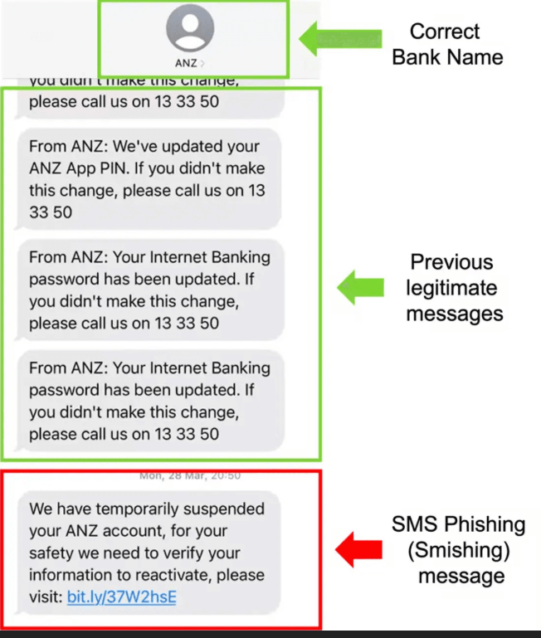
Sample phishing scam

Slide 10
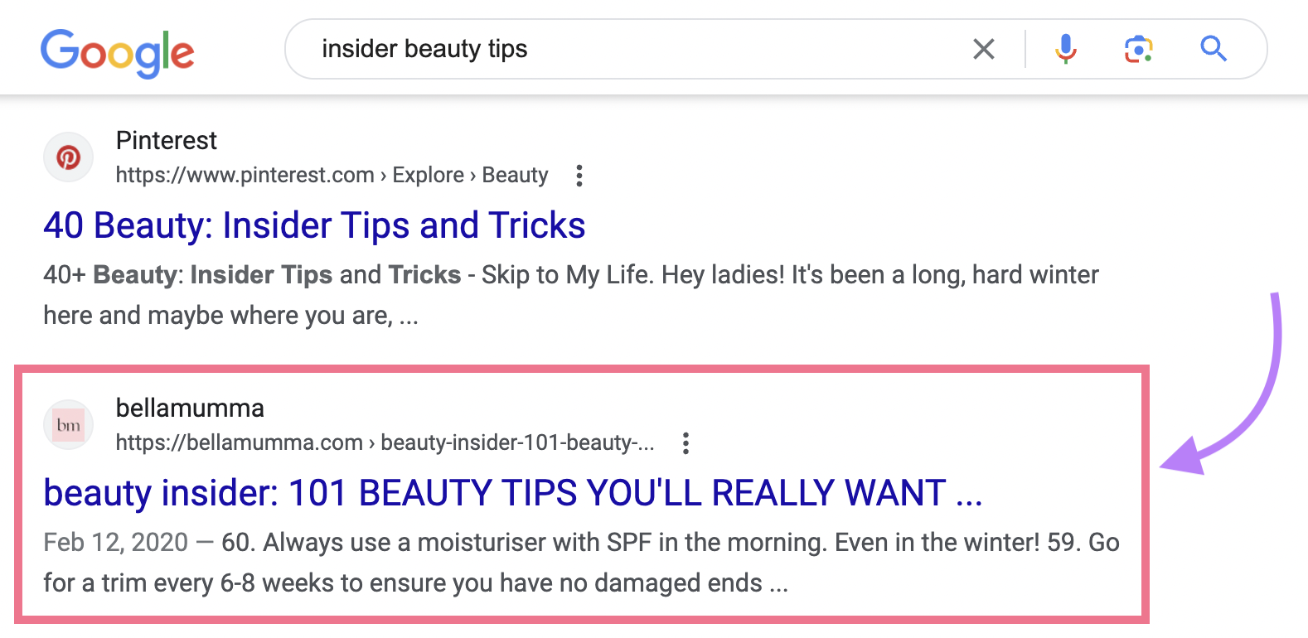
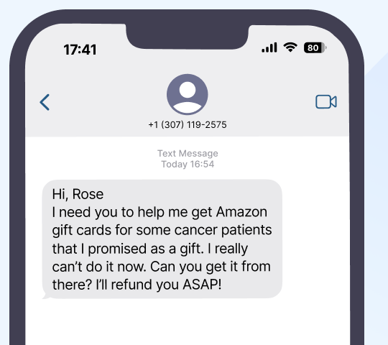
Sample clickbait and sweetheart scam

Slide 11
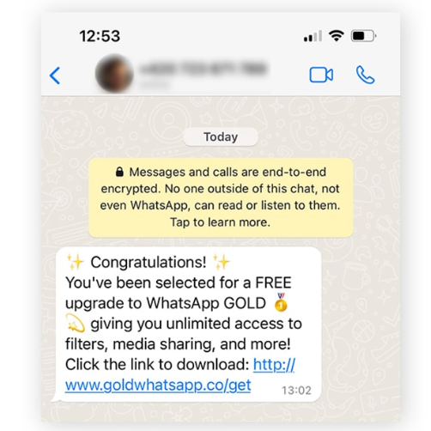
Sample approval scam

Slide 12
What to do if you think your identity has been stolen
Contact your bank or credit union right away!
They can help with next steps such as:
Canceling compromised debit and credit cards
Updating passwords on affected accounts and any with similar credentials
Placing a fraud alert with a major credit bureau (Experian, TransUnion or Equifax)
Freezing your credit
Requesting reports from creditors and debt collectors
Filing a report with local law enforcement or at identitytheft.gov
Enrolling in a credit monitoring service
Source: OnPoint Community Credit Union. (2025). OnPoint Guide to Personal Cybersecurity.
Notes:
Review with students the information provided.
Point students to the Tips for Staying Safe handout and give them a few moments to review. It provides general tips and strategies for protecting financial well-being, including instructions for responding to suspected identity theft.
Emphasize for students the importance of contacting a bank or credit union right away if they suspect identity theft or fraud. Financial institutions can take immediate actions to stop or limit fraud, such as cancelling debit and credit cards and recovering money from unauthorized charges. They can also offer helpful tools and advice.

Slide 13

Break
Notes:
Optional break.

Slide 14

Application Activity
Notes:
Divide the class into small groups.

Slide 15
Activity instructions
Work with your group to read each scenario
Identify the type of scam or fraud being described and write the scam type in the space provided
Explain one way to avoid falling victim to the scam (use the “Tips for Staying Safe” handout for ideas and support)
Be prepared to discuss your work with the class
Notes:
Point students to the Spot the Scam handout. Review the activity instructions as a class. Students will work in groups to discuss several scenarios, decide what type of scam or fraud it represents, and describe how they can avoid falling victim to it using the spaces provided in the handout.
Re-display the Types of Scams slides (Slides 7-8) so students can refer to it as they work on the activity.
Invite groups to begin working.
Circulate among the groups as they work to answer questions and make sure they are staying on task.
After 15 minutes, or when it looks like the groups have completed the activity, get their attention and move on to the activity debrief.

Slide 16

Debrief
Notes:
Using the Spot the scam answer key slides (Slides 17-20), have students compare their work with the answers provided on the slides.
If students have questions about or disagree with any of the suggested answers, encourage them to explain their reasoning.
Students’ answers do not need to match the exact wording as long as they are conceptually or directionally correct.

Slide 17
Spot the scam answer key (Scenarios 1-2)
Bank Account Locked Text Message
  Scam Type: Phishing
  How to Avoid It: Don't click suspicious links. Contact your bank directly using a trusted phone number or website
Online Friend Requests Money
  Scam Type: Sweetheart Scam
  How to Avoid It: Never send money to someone you've only met online. Talk to a trusted adult if something seems suspicious

Slide 18
Spot the scam answer key (Scenarios 3-4)
Unexpected $500 Gift Card Prize
  Scam Type: Too-Good-to-Be-True Scam / Phishing
  How to Avoid It: Don't share personal information to claim prizes you never entered to win
Fake Family Emergency Call
  Scam Type: Sweetheart Scam / Phishing
  How to Avoid It: Contact the family member directly before sending money. Never send money through gift cards

Slide 19
Spot the scam answer key (Scenarios 5-6)
$5 AirPods Online Ad
  Scam Type: Clickbait / Too-Good-to-Be-True Scam
  How to Avoid It: Research the seller and avoid deals that seem unrealistically good
Pre-Approved Student Loan Email
  Scam Type: Fake Approval / Phishing
  How to Avoid It: Verify the offer through official channels and never share sensitive information by email

Slide 20
Spot the scam answer key (Scenario 7)
Unknown Subscription Charge
  Scam Type: Identity Theft
  How to Avoid It: Monitor your accounts regularly and report unauthorized charges immediately

Slide 21

Wrap-Up

Slide 22
Exit ticket
One scam or type of fraud I learned about today is __________.
A warning sign of fraud or identity theft is __________.
One thing I can do to stay safe online is __________.
Notes:
Point students to the copy of the prompts on the slide that is provided on the last page of their handout packets. Invite students to write their responses to the prompts in their handouts in the spaces provided.

Slide 23

Thank you!
Notes:
Answer any final questions and thank students for their participation.

