Slide 1
OnPoint Financial Literacy Education
Lesson 1: Money and Me
Notes:
Distribute the handout packets to students, if you have not already.

Slide 2
Warm-up
What are three words that describe how you feel about money?
Notes:
Point students to the copy of the prompt on the slide (What are three words that describe how you feel about money?) that is provided on the first page of their handouts.
Invite students to take a moment to write down their responses to the prompt in the space provided in their handouts. Tell them there are no right or wrong answers—they should simply write whatever comes to mind.

Slide 3
Learning targets
I can:
Identify factors that influence my money choices
Recognize and avoid pressure when making money decisions
Create financial goals based on my values and priorities
Notes:
Point students to the copy of the learning targets provided on the first page of their handouts. Review the learning targets with them.
Point students to the copy of the lesson glossary provided on the first page of their handouts and review the terms with them.
Point students to the Note Catcher handout and invite them to use it to take notes during the lesson.

Slide 4

Presentation

Slide 5
Your “relationship” with money
Money affects how you feel, how you behave, and how you make decisions—just like other important relationships in your life
Everyone has a unique relationship with money based on their experiences, upbringing, culture, and personality
Notes:
Acknowledge that it might feel strange to say that people have a “relationship” with money because money is not a person. However, thinking of money in this way helps us notice our habits, feelings, and reactions around spending and saving. It gives us a simple way to understand why we make certain money choices. This lesson builds the foundation for other lessons students will explore later: once they understand their own money mindset, it becomes easier to learn how to budget, plan, save, invest, and make smart financial decisions.
Point students to the My Money Mindset handout and review the instructions with them. Explain that they will answer questions designed to help them gain insight into their own psychology around money. Let them know there are no right or wrong answers and that they should answer in whatever way feels true to them.
Give students 10 minutes to work independently and silently to answer the questions in the handout.
After 10 minutes, or when most students appear to have finished their work, get their attention.
Invite a few volunteers to briefly share general reflections about what they wrote with the whole class—not the personal details of their answers.
Ask: What did you notice about your money mindset?
Briefly summarize patterns you hear in student responses, connecting them to the idea that our money choices are shaped by more than numbers. They are also influenced by emotions, cultural expectations and social pressures.

Slide 6

Teens and money
What social pressures do teens encounter around money?
Notes:
Invite a few volunteers to share their responses to the prompt provided (What social pressures do teens encounter around money?). Write their responses on the classroom writing surface.
Thank students for their responses and explain that understanding these pressures will help them recognize when they are making choices based on their values and when they might be reacting to stress or outside influences.

Slide 7

Application Activity
Notes:
Divide the class into small groups.

Slide 8
Activity instructions
Find a school-appropriate online advertisement on a web or social media page, post, or app (or use the one provided)
Describe, sketch or take a screenshot of the ad
Analyze the ad using the questions and prompts in the handout
Prepare a short (30-second) report on your work to share with the class
Notes:
Point students to the Spot the Manipulation handout. Review the activity instructions with them. Students will work in groups to find and examine a school-appropriate online advertisement—or analyze a provided example (see the “Preparation” section of the lesson plan)—and identify the techniques it uses to influence consumer behavior.
If using examples you pre-selected for students, share or distribute them now.
Invite students to begin the activity.
Circulate among the groups as they work to answer questions and make sure they are staying on task.
After 18 minutes, or when it appears that groups have completed their work, get their attention and move on to the activity debrief.

Slide 9

Break
Notes:
Optional break.

Slide 10

Debrief
Notes:
Ask each group to briefly share the product or service that was the focus of its advertisement and one persuasive technique the advertisement used.
Thank students for their work and explain that being aware of manipulative advertising techniques can help them make more intentional decisions about saving and spending. Invite them to continue looking for examples of these techniques in real life.
Point students to the Me at 20, 40, 60 and 80 handout and review the instructions with them. Explain that they will work independently and silently to imagine their lives at different ages and consider how they might use money to meet their needs and priorities. Reassure them that there are no right or wrong answers, and they should respond in whatever way best reflects their goals and perspectives.
Give students about eight minutes to complete the handout. After eight minutes, or when it appears that most students have completed the activity, get their attention and move on to the lesson wrap-up.

Slide 11

Wrap-Up

Slide 12
Exit ticket
My money choices are influenced by __________.
When I feel pressure to spend, I will __________.
One financial goal that reflects my values is __________.
Notes:
Point students to the copy of the prompts on the slide that is provided on the last page of their handout packets. Invite students to write their responses to the prompts in their handouts.

Slide 13
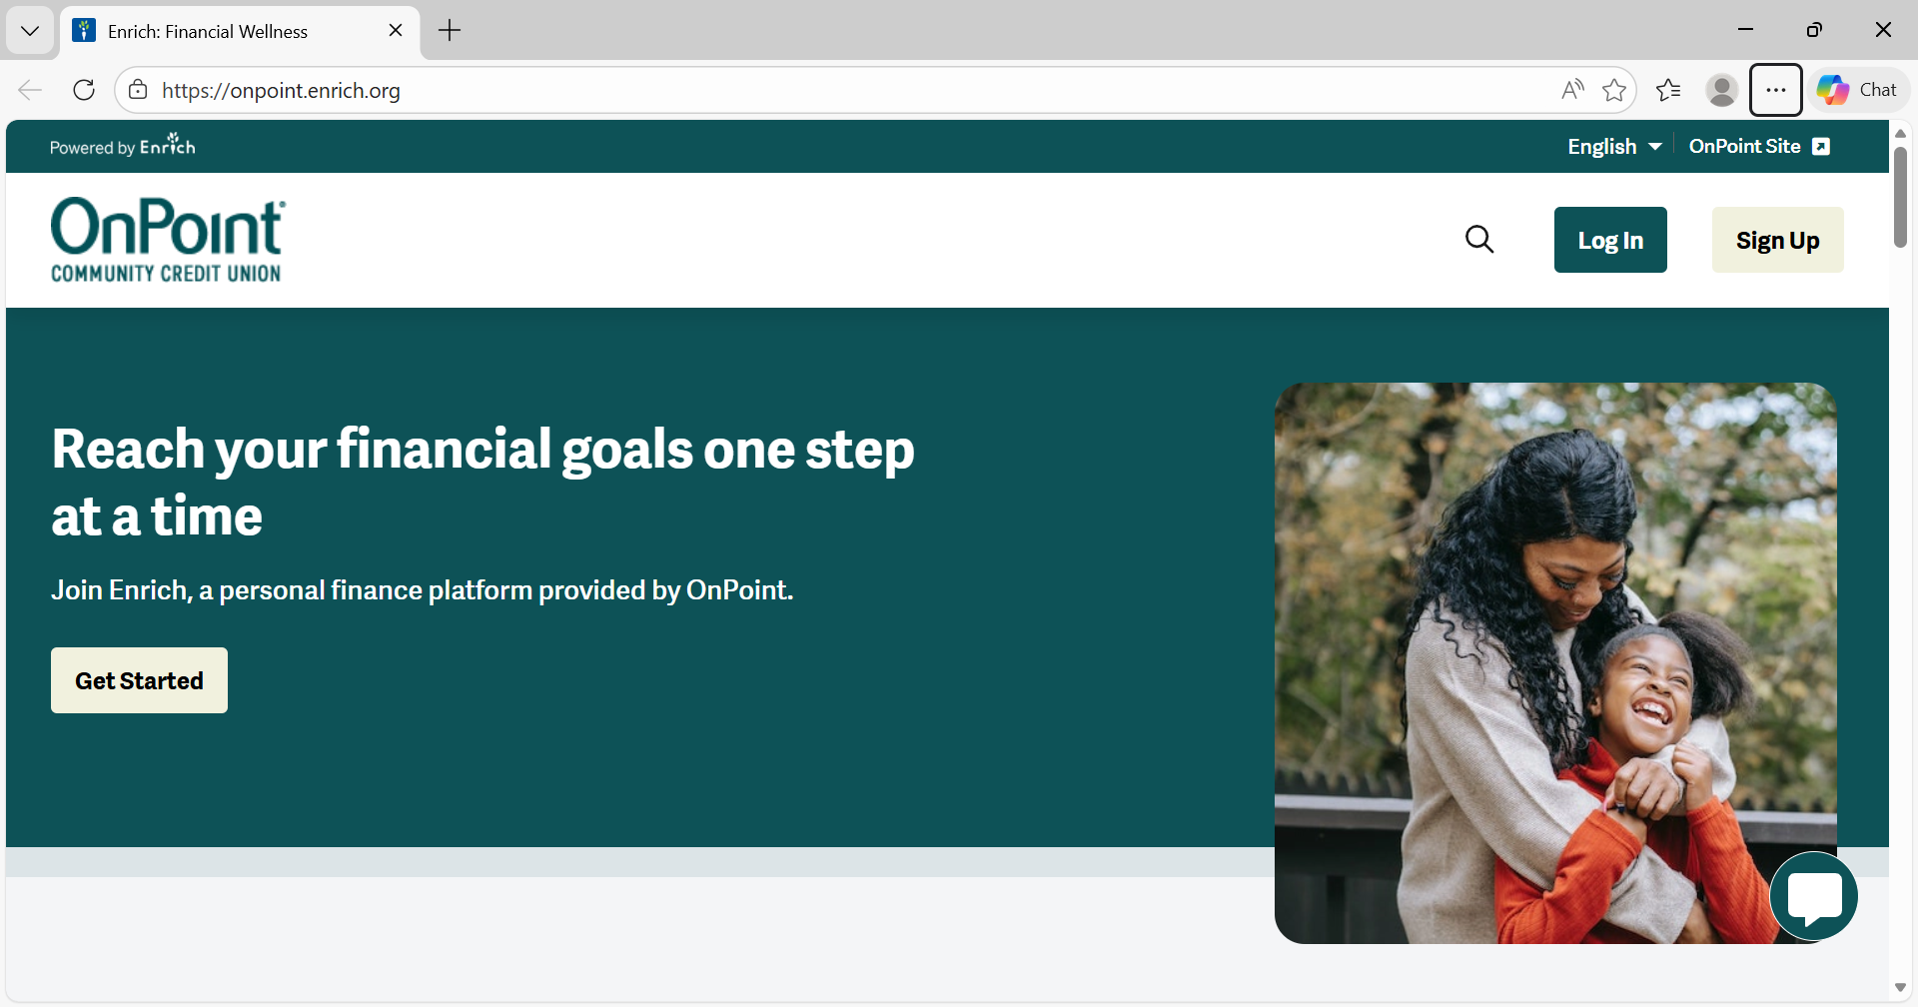
Learn and practice money skills
Online tools and apps
Can help you learn and practice real-life money skills like budgeting, saving, spending, and investing
  Enrich
  Next Gen Personal Finance Arcade
Image source: OnPoint
Notes:
Explain that there are many interactive online resources students can use to learn more about personal finance in a fun and engaging way. The slide provides links to two examples.
Ask for a few volunteers to share additional financial learning resources with which they are familiar and write those resources on the classroom writing surface.

Slide 14

Thank you!
Notes:
Answer any final questions and thank students for their participation.

