Slide 1

OnPoint Financial Literacy Education
Lesson 2: Managing Your Money
Notes:
Distribute the handout packets to students, if you have not already.

Slide 2
Warm-up
Why do we need to keep track of and manage our money?
Notes:
Point students to the copy of the prompt on the slide (Why do we need to keep track of and manage our money?) that is provided on the first page of their handouts.

Slide 3
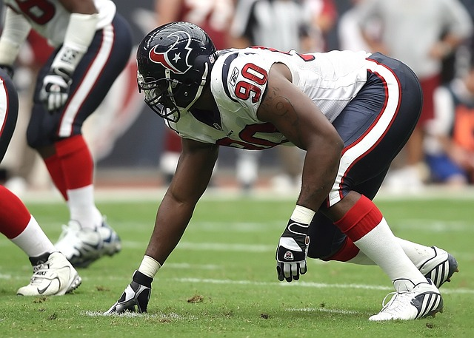
Poor planning
According to Sports Illustrated, “[b]y the time they have been retired for two years, 78% of former NFL players have run out of money or are under financial stress; within five years after retirement, an estimated 60% of former NBA players are broke.”
Source: Torre, P.S. (March 23, 2009). How and why athletes go broke. Sports Illustrated.
Image source: Pixabay
Notes:
Ask students why they think financially successful athletes could run out of money. Suggestions you can offer include:
Pro athletes often have a very short career. They must manage what they earn to last them through a long retirement.
Young athletes often do not have a lot of financial knowledge to manage the large amounts of money they earn.
Many athletes who earn a lot of money also spend a lot of money. When they stop earning money, they may have bills to pay or want to keep living a luxurious lifestyle they can no longer afford.
Remind students of their work identifying financial goals in Lesson 1, Money and Me. Explain that financial planning can help them achieve their short-term and long-term financial goals, whether that is saving for a car or to help pay for college or career training. It can also help them avoid making the types of financial mistakes they learned professional athletes can make.

Slide 4
Learning targets
I can:
Explain why financial planning is important and how it can help me reach my goals
Identify different types of income, expenses, and savings
Distinguish between wants, needs, and obligations when creating a budget
Notes:
Point students to the copy of the learning targets provided on the first page of their handouts. Review the learning targets with them.
Point students to the copy of the lesson glossary provided on the first page of their handouts and review the terms with them.
Point students to the Note Catcher handout and invite them to use it to take notes during the lesson.

Slide 5

Presentation

Slide 6
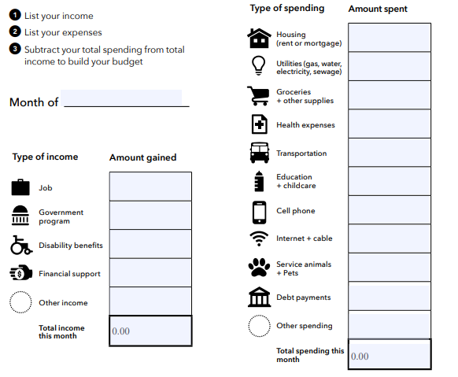
What is a budget?
A plan that details money you expect to earn or receive and how you will spend or save it. It is generally composed of:
Income: Money received from jobs, allowances, gifts, interest, dividends, and other sources
Expenses: The cost of goods or services
Savings: Money set aside from your income to use in the future
Image source: Adapted from Consumer Financial Protection Bureau, Monthly Budget
Notes:
Note that a budget is a common financial planning tool used by many people to make decisions about their money. Review with students the definitions of income, expenses, and savings.

Slide 7

Earned (active) income
Money you earn from working for yourself or others
  Wages and salaries
  Tips
  Bonuses and commissions
  Money earned from gigs or side hustles

Slide 8
Unearned (passive) income
Money you earn without working
  Allowances
  Gifts
  Interest on bank accounts
  Investment income

Slide 9

Fixed expense
An expense that does not change over time
  Phone bill
  Streaming subscription
  Gym membership
  Car payment

Slide 10
Variable expense
An expense that varies over time
  Clothing
  Food and snacks
  Entertainment
  School supplies
Notes:
Ask students to share three examples of ways teenagers earn money and three examples of expenses that teenagers may have. Record their responses on the writing surface.
As a class, review each example and have students determine the appropriate category. Ask students to classify income examples as either earned or unearned income and expense examples as either fixed or variable expenses. Mark each example with the appropriate label as students identify the correct classification.

Slide 11
Savings timeline
Short-term:
Savings for immediate needs, upcoming events, short-term goals, and emergencies (unexpected expenses)
Medium-term:
Savings for expenses coming in a few years, such as major purchases, vacations, and a deposit for an apartment
Long-term:
Savings for life events and goals that require lots of money, such as buying a house or retiring
Notes:
Emphasize the importance of an emergency or “rainy day” fund in a healthy financial plan to provide protection from life’s uncertainties.

Slide 12
Wants, needs, and obligations
A want
is something you would like to have but can live without
A need
is something you must have to survive and stay healthy
An obligation
is something you are required to do by law, rules, or personal responsibility
Notes:
Ask students to consider how these categories influence spending decisions and financial priorities.
Facilitate a brief discussion connecting the two concepts of savings timelines and wants, needs, and obligations. Explain that budgeting involves making choices about how to use limited financial resources. People often budget so they can meet their obligations and needs while also setting aside money for emergency savings and future goals.
Ask students to share examples of savings goals they might have and identify which expenses they would prioritize reducing to achieve that goal.

Slide 13
Want, need, or obligation?
Item | Want | Need | Obligation
A weekend trip
Car payment
Concert tickets
Groceries
Housing
Medicine
Student loan payment
Taxes
The latest smartphone
Notes:
Review each item on the slide one at a time and ask students to quickly decide whether it represents a want, need, or obligation. Have students indicate their responses with a show of hands.

Slide 14
Want, need, or obligation? (Answers)
Item | Want | Need | Obligation
A weekend trip
Car payment
Concert tickets
Groceries
Housing
Medicine
Student loan payment
Taxes
The latest smartphone
Notes:
Review the suggested answers with students and compare them to the class responses. Facilitate a brief discussion of any items that generated differing opinions, emphasizing that some spending decisions may depend on a person's circumstances. Reinforce that understanding the difference between wants, needs, and obligations can help people make informed budgeting decisions and prioritize their spending.

Slide 15
Cash flow
The amount of money you have coming in as income minus the money going out to pay for expenses
  Positive cash flow: More money is coming in than going out
  Negative cash flow: More money is going out than coming in
Notes:
Explain that cash flow refers to the money coming in (income) compared to the money going out (expenses). Emphasize that understanding cash flow helps people make informed decisions about spending, saving, and budgeting.

Slide 16
Budgeting steps
Keep track of your spending
Identify your income and expenses
Build a budget that balances needs, wants, and savings. One example is the 50-30-20 budget:
  50 percent needs
  30 percent wants
  20 percent savings
Look for ways to increase your income and decrease your expenses
Notes:
Review the budgeting steps with students and briefly summarize the key concepts covered in the lesson, including income, expenses, savings, and wants, needs, and obligations. Explain that successful budgeting involves balancing these components to make informed financial decisions and work toward financial goals.
Highlight the “50-30-20 budget” as one example of how people may choose to allocate their money among needs, wants, and savings. Remind students that this approach may not work for everyone and that individuals should develop a budgeting strategy that fits their own financial situation and priorities.
Reinforce that a successful budget is one that helps people meet their needs, save for future goals, and manage their money responsibly. Encourage students to think about how they might apply these concepts when making financial decisions in their own lives.

Slide 17

Break
Notes:
Optional break.

Slide 18

Application Activity
Notes:
Divide the class into small groups.

Slide 19
Activity instructions
Analyze a provided scenario and use its information to:
Create a monthly budget
Calculate cash flow (positive or negative)
Identify income and expense types
Determine if the financial goal can be achieved
Classify the goal as short-, medium-, or long-term
Recommend changes to income, expenses, or savings to help achieve the goal
Expense Item | Amount
Phone bill | $50
Gas | $160
Entertainment | $150
Lunches and snacks | $75
Total Expenses | $435
Notes:
Review the activity instructions as a class. Students will analyze a budgeting scenario, use the information provided to create a monthly budget, calculate cash flow, and determine whether the cash flow is positive or negative. They will then answer follow-up questions to identify the types of expenses in the scenario, determine whether the individual is likely to achieve their financial goal, classify the goal as short-, medium-, or long-term, and provide recommendations for adjusting income or expenses to help achieve the goal.
To model the activity and help students get started, review the sample scenario and monthly budget for Jordan as a whole class. Guide students through identifying sources of income and expenses, calculating total income and total expenses, and determining whether the budget results in a surplus or shortfall.
Assign each student group one scenario in the “Your Turn!” section of the handout and invite them to begin the activity.
Circulate among the groups as they work to answer questions and make sure they are staying on task.
When it looks like groups have completed their work, get their attention and move on to the activity debrief.

Slide 20

Debrief
Notes:
Using the Budgeting scenarios answer key slides (Slides 21-24), have student groups compare their work with the suggested answers provided on the slides. Invite groups to share and discuss their responses with the class. If students have questions about or disagree with any of the suggested answers, encourage them to explain their reasoning and support their conclusions with evidence from their scenario. Acknowledge that some of the suggested answers are nuanced. For example, certain expenses may reasonably be classified as either needs or wants depending on the individual's circumstances, and some financial goals may be considered either short- or medium-term.
Have each group briefly share its recommendations for adjusting the budget in their scenario to meet the financial goal. Help students recognize that reaching financial goals often requires increasing income, reducing expenses, using savings, or a combination of these strategies. Highlight any groups that make this connection and reinforce that adjusting income, spending, and savings are common ways to achieve financial goals.

Slide 21
Budgeting scenarios answer key: Scenario 1 (Cole)
Income Source | Amount
Teaching swimming lessons | $600
Selling vintage clothing | $200
Total Income | $800
Expense Item | Amount
Phone bill (Fixed, Need) | $60
Gas (Variable, Need) | $200
Car insurance (Fixed, Obligation) | $150
Taekwondo classes (Fixed, Want) | $250
Total Expenses | $660
Monthly cash flow: $800 (income) - $660 (expenses) = $140 (surplus) = Positive
Goal: Save $1,500 over six months (Medium-term goal)
Will he reach it? No ($140 x 6 months = $840, $660 less than $1,500)

Slide 22
Budgeting scenarios answer key: Scenario 2 (Maria)
Income Source | Amount
Refereeing soccer and lacrosse | $700
Total Income | $700
Expense Item | Amount
Gas and insurance (Variable, Need) | $300
Phone bill (Fixed, Need) | $65
Clothing (Variable, Want) | $200
Gifts (Variable, Want) | $150
Total Expenses | $715
Monthly cash flow: $700 (income) - $715 (expenses) = -$15 (shortfall) = Negative
Goal: Pay her parents back $50 a month for one year (Medium-term goal)
Will she reach it? No (Her expenses already exceed her income)

Slide 23
Budgeting scenarios answer key: Scenario 3 (Alex)
Income Source | Amount
Cookie bakery job | $500
Total Income | $500
Expense Item | Amount
Gas and insurance (Variable, Need) | $250
Phone bill (Fixed, Need) | $80
Lunches and snacks (Variable, Want) | $150
Entertainment (Variable, Want) | $100
Total Expenses | $580
Monthly cash flow: $500 (income) - $580 (expenses) = -$80 (shortfall) = Negative
Goal: To avoid borrowing money from his parents and better manage spending (Short-term goal)
Will he reach it? No (His expenses are higher than his income)

Slide 24
Budgeting scenarios answer key: Scenario 4 (Morgan)
Income Source | Amount
Babysitting | $400
Total Income | $400
Expense Item | Amount
Phone bill (Fixed, Need) | $60
Bus pass (Fixed, Need) | $65
Entertainment (Variable, Want) | $100
Eating out (Variable, Want) | $100
Total Expenses | $325
Monthly cash flow: $400 (income) - $325 (expenses) = $75 (surplus) = Positive
Goal: Save $100 a month for a summer trip (Short-term goal)
Will she reach it? No (She doesn’t have enough income to cover expenses and save $100)

Slide 25

Wrap-Up

Slide 26
Exit ticket
One thing I learned about budgeting is __________.
One example of a want, need, or obligation is __________.
One way a budget can help someone reach a financial goal is __________.
Notes:
Point students to the copy of the prompts on the slide that is provided on the last page of their handout packets. Invite students to write their responses to the prompts in their handouts in the spaces provided.

Slide 27

Thank you!
Notes:
Answer any final questions and thank students for their participation.

