Slide 1

OnPoint Financial Literacy Education
Lesson 3: Budgeting for Real Life
Notes:
Distribute the handout packets to students, if you have not already.

Slide 2
Warm-up
What new expenses do students often face after high school?
Notes:
Point students to the copy of the prompt on the slide (What new expenses do students often face after high school?) that is provided on the first page of their handouts.
Invite students to take a moment to write down their responses to the prompt in the space provided in their handouts. Tell them there are no right or wrong answers—they should simply write whatever comes to mind.
Invite a handful of volunteers to share their ideas with the whole class and write down what they share on the writing surface.
Share that budgeting is a valuable tool for managing money and making informed financial decisions as students take on more financial responsibilities after graduation. Explain that a budget helps people plan for both planned expenses, such as rent, groceries, and transportation, and unplanned expenses, such as car repairs or medical bills. A resilient budget includes room for savings and unexpected costs, helping individuals manage financial challenges, adapt to changes, and stay on track toward their financial goals.

Slide 3
Learning targets
I can:
Create a realistic monthly budget
Adjust a budget when income or expenses change
Use an online budget calculator to build and review a budget
Notes:
Point students to the copy of the learning targets provided on the first page of their handouts. Review the learning targets with them.
Point students to the copy of the lesson glossary provided on the first page of their handouts and review the terms with them.
Point students to the Note Catcher handout and invite them to use it to take notes during the lesson.

Slide 4

Presentation
Notes:
Point students to the Common Monthly Budget Categories handout.
Have students pair up and review the handout. Invite them to circle budget items they see that the class identified through the brainstorm in the previous activity, underline any categories or words they are unfamiliar with, and write in in the blank spaces at the end of the handout any categories they think are missing.
After giving pairs about five minutes to work, get their attention and debrief the activity by inviting volunteers to share what they circled, underlined, and added to the handout.
Note that the handout provides common income, savings, and expense categories, but it is not exhaustive. Add that students will become very familiar with many of the categories as they graduate from high school and establish their lives as adults.

Slide 5
Budget boosts and bites
Scenario | Boost or Bite?
Getting a bonus or raise at work
Having an unexpected car repair
Losing a job or working fewer hours
Getting money as a gift
Receiving a medical bill after an illness or accident
Purchasing a “want” item on impulse
Paying off a credit card or car loan
Notes:
Review each item on the slide one at a time and ask students to quickly decide whether it represents an event or activity that helps or hurts a budget. Have students indicate their responses with a show of hands.

Slide 6
Budget boosts and bites (Answers)
Scenario | Boost or Bite?
Getting a bonus or raise at work
Having an unexpected car repair
Losing a job or working fewer hours
Getting money as a gift
Receiving a medical bill after an illness or accident
Purchasing a “want” item on impulse
Paying off a credit card or car loan
Notes:
Review the suggested answers with students and compare them to the class responses. Facilitate a brief discussion of any items that generated differing opinions.
Ask students to think about what choices people might make with their budgets if they receive an unexpected boost in income such as from a raise or a gift. Take suggestions from students and write them on the writing surface. Some ideas to suggest if students do not mention them include saving or investing the extra money, paying off debts, adding to their emergency fund, giving to charity, and treating themselves to a “want” item if their financial basics are covered.
Ask students to think about what choices people might make with their budgets if they face an unexpected expense like a medical bill or car repair. Take suggestions from students and write them on the writing surface. Some ideas to suggest if students do not think of them include using their emergency fund or savings to cover the costs, cutting back on non-essential spending, and delaying spending on “want” items.

Slide 7
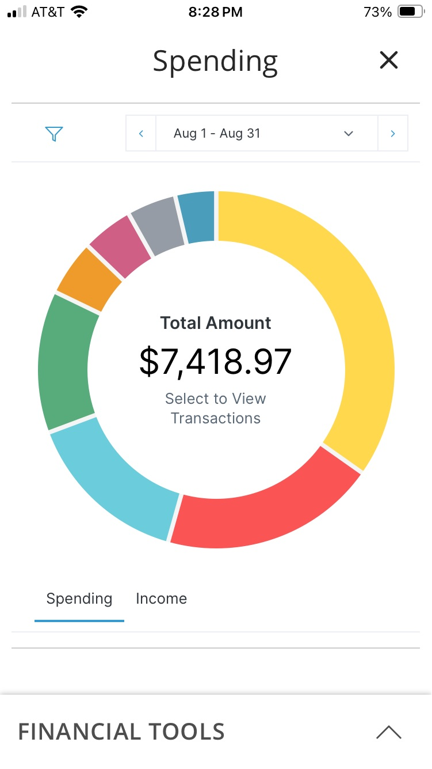
Budgeting tools and apps
Many organizations offer free budgeting tools online
Budgeting tools can help you stay on track with your money goals.
Use budgeting tools safely and protect your information​
Image source: OnPoint
Notes:
Explain that online budgeting tools and apps can help students track spending, set savings goals, and manage changes in income or expenses. Many banks, credit unions, government agencies, and nonprofits offer free budgeting tools. Remind students to protect their personal and financial information when using budgeting apps and websites.

Slide 8

Application Activity
Notes:
Divide the class into small groups.

Slide 9
Activity instructions
Analyze a provided scenario and use its information to:
Build a budget using an assigned scenario in your handout and in an online budget calculator
Update your budget in response to three unexpected “curveballs”
Discuss and record how you would adjust your income, expenses, or savings after each change
Complete the reflection questions together
Prepare to share your work with the class
Notes:
Point students to the Budget Curveballs handout. Review the activity instructions as a class. Students will record the monthly income and expense amounts from an assigned scenario on the budget form provided in the handout. Next, they will use a free online budget calculator (see the “Preparation” section of the lesson plan) to enter the income and expense information and create an initial budget. As students work, they will be presented with a series of three budget “curveballs” that introduce unexpected changes to their financial situation. After each curveball, students will update their budget, discuss how they could adjust their income, expenses, or savings to respond, and record their revised budget information on the handout. After completing all three curveballs, groups will answer reflection questions and prepare to share their ideas and budget decisions with the class.
Assign each student group one scenario and invite them to begin the activity.
Circulate among the groups as they work to answer questions and make sure they are staying on task.
When all student groups have recorded their income and expense information in the handout and copied it into the online calculator, get their attention.

Slide 10
Curveball 1
Your car insurance premium or bus pass increases by $50 a month.
Notes:
Have students review the information on the slide.
Have students update their budgets in the online calculator to reflect the change, discuss how they would adjust their income, expenses, or savings, and record their revised income and expense figures in the “Curveball 1” column of the monthly budget form in the handout.

Slide 11
Curveball 2
You get sick and stay home from work for several days, losing $250 in income for the month.
Notes:
Have students review the information on the slide.
Have students update their budgets in the online calculator to reflect the change, discuss possible adjustments to their income, expenses, or savings, and record their revised figures in the “Curveball 2” column of the monthly budget form in the handout.

Slide 12
Curveball 3
Relatives give you $500 for your graduation.
Notes:
Have students review the information on the slide.
Have students update their budgets in the online calculator to reflect the additional income, discuss how they might adjust their spending or savings plans, and record their revised figures in the “Curveball 3” column of the monthly budget form in the handout.
Have groups discuss and respond to the reflection questions at the end of their handouts.
When it looks like groups have completed their work, get their attention and move on to the activity debrief.

Slide 13

Break
Notes:
Optional break.

Slide 14

Debrief
Notes:
Invite a spokesperson from each group to briefly explain how the group responded to the budget curveballs, including the changes they made to their income, expenses, or savings. Encourage groups to share their reasoning and discuss how their decisions affected their ability to stay on track toward their financial goals.

Slide 15
Building resilient budgets
Build an emergency fund for unexpected expenses
Review and update your budget regularly
Pay for needs before spending on wants
Save money automatically whenever possible
Notes:
Reinforce that a strong budget is flexible and helps people prepare for both expected and unexpected expenses. Remind students that regularly reviewing their budget, prioritizing needs, and consistently saving can help them stay on track and reach their financial goals even when circumstances change.

Slide 16

Wrap-Up

Slide 17
Exit ticket
One thing I need to include in a monthly budget is __________.
If my income or expenses change, I can adjust my budget by __________.
One way an online budget calculator can help me is __________.
Notes:
Point students to the copy of the prompts on the slide that is provided on the last page of their handout packets. Invite students to write their responses to the prompts in their handouts in the spaces provided.

Slide 18

Thank you!
Notes:
Answer any final questions and thank students for their participation.

