Slide 1

OnPoint Financial Literacy Education
Lesson 4: The Power of Interest
Notes:
Distribute the handout packets to students, if you have not already.

Slide 2
Warm-up
What do you know about interest?
Where have you heard the term before?
Notes:
Point students to the copy of the prompts on the slide (What do you know about interest? Where have you heard the term before?) that is provided on the first page of their handouts.
Invite students to take a moment to write down their responses to the prompts in the space provided in their handouts. Tell them there are no right or wrong answers—they should simply write whatever comes to mind.
Invite a handful of volunteers to share their ideas with the whole class and write down what they share on the writing surface.

Slide 3
Which would you choose?
Would you rather have a penny that doubles every day for 30 days or one million dollars right now?
Notes:
Read the prompt on the slide out loud for the class or invite a student to do so (Would you rather have a penny that doubles every day for 30 days or one million dollars right now?).
Ask students to vote on which choice they would make with a show of hands.
Invite a handful of students to briefly explain their thinking to the class.

Slide 4
Penny versus $1M
Day | Amount
1 | 0.01
5 | 0.16
10 | 5.12
15 | 163.84
20 | 5,242.88
25 | 167,772.16
28 | 1,342,177.28
29 | 2,684,354.56
30 | 5,368,709.12
Choosing a penny that doubles in value every day for 30 days is better than taking $1 million today.
Thanks to the power of interest, that penny grows to more than $5.3 million by Day 30. The example shows how small amounts of money can grow significantly over time.
Notes:
Explain how the penny doubling daily for 30 days ends up worth five times more than one million dollars. The penny grows so much because each day's increase is added to the total before the next day's growth occurs. This is the idea behind interest, which students will explore in this lesson.

Slide 5
Learning targets
I can:
Explain what interest is
Compare how simple and compound interests affect savings and loans over time
Use interest information to make informed saving and borrowing decisions
Notes:
Point students to the copy of the learning targets provided on the first page of their handouts. Review the learning targets with them.
Point students to the copy of the lesson glossary provided on the first page of their handouts and review the terms with them.
Point students to the Note Catcher handout and invite them to use it to take notes during the lesson.

Slide 6

Presentation

Slide 7
Key terms
Interest:
Extra money you either earn or pay when dealing with financial institutions
Principal:
A sum of money you borrow or set aside to save
Interest rate:
The extra money earned or paid for the use of money over time expressed as a percentage
Notes:
Briefly review each term and explain how they work together: the principal is the amount of money being saved or borrowed, the interest rate determines how much interest is earned or paid over time, and interest is the extra money earned on savings or paid on borrowed money.

Slide 8
Power of time
When saving:
More time means more interest earned
Starting early gives your money more time to grow
When borrowing:
More time means more interest paid
Paying off loans sooner can save money
Notes:
Explain that time is one of the most important factors affecting how interest works. When saving, more time gives money more opportunity to grow. When borrowing, more time usually increases the total amount of interest paid. Emphasize that interest can work either for or against a person depending on whether they are saving or borrowing.

Slide 9
Simple interest
To calculate simple interest (SI):
SI = P × R × T
Where:
P = Principal (the original amount of money borrowed or saved)
R = Annual interest rate (as a decimal)
T = Time (the duration in years)
The amount of interest calculated only on the original principal, not on any interest earned or added over time
Notes:
Review the definition and formula for simple interest. Explain that simple interest is calculated only on the original principal, resulting in a predictable amount of interest over time. Simple interest is commonly used for certain loans and other forms of short-term borrowing.

Slide 10
Simple interest example
Question:
If you deposit $1,000 in a savings account at 5% simple interest per year for 3 years, how much interest will you earn, and what will your new principal be?
Use the formula: SI = P × R × T
Solution:
Principal (P) =
Rate (R) =
Time (T) =
SI =
You will have earned $___ in interest.
The new principal will be:
Notes:
Review the example with students. Have students work with a partner to calculate the interest earned and new principal.

Slide 11
Simple interest example (Answer)
Question:
If you deposit $1,000 in a savings account at 5% simple interest per year for 3 years, how much interest will you earn, and what will your new principal be?
Use the formula: SI = P × R × T
Solution:
Principal (P) = $1,000
Rate (R) = 5% = 0.05
Time (T) = 3 years
SI = $1,000 × 0.05 × 3
SI = $150
You will have earned $150 in interest.
The new principal will be
$1,000 + $150, or $1,150.
Notes:
Review the solution as a class. Answer any questions students may have about the calculation.

Slide 12
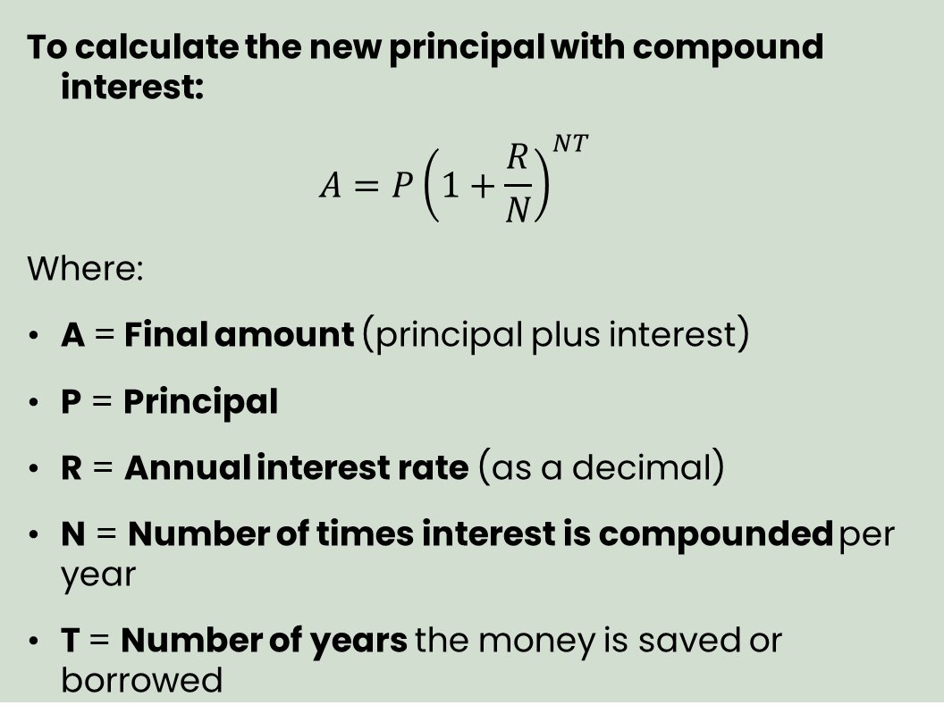
Compound interest
Interest earned on both the original principal and on any interest that has already been added, causing the total to grow faster over time
Common compounding periods include daily, monthly, quarterly, semiannually, and annually
To calculate the new principal with compound interest:
$$A=P{\left(1+\frac{R}{N}\right)}^{NT}$$
Where:
A = Final amount (principal plus interest)
P = Principal
R = Annual interest rate (as a decimal)
N = Number of times interest is compounded per year
T = Number of years the money is saved or borrowed
Notes:
Review the definition and formula for compound interest. Explain that compound interest is calculated on both the original principal and previously earned interest. Add that how often interest is added to an account or loan—the compounding period—matters. The more frequently interest is compounded, such as monthly instead of yearly, the faster savings can grow and the faster debt can increase because interest is being earned or charged on previous interest more often.

Slide 13
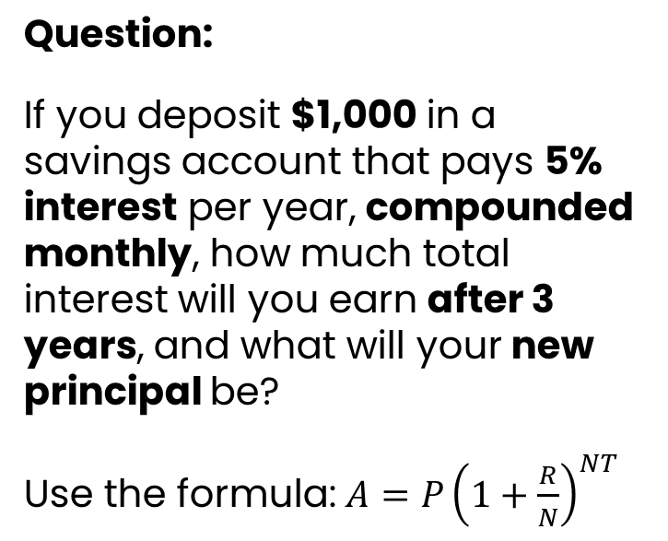
Compound interest example
Question:
If you deposit $1,000 in a savings account that pays 5% interest per year, compounded monthly, how much total interest will you earn after 3 years, and what will your new principal be?
Use the formula: $A=P{\left(1+\frac{R}{N}\right)}^{NT}$
Notes:
Review the example with students. Explain that because compound interest calculations become more complex over time, many people use online calculators to determine compound-interest growth.
Open the link to an online interest calculator (see “Preparation” section of the lesson plan).
Walk students through how to use the online calculator to determine the compound-interest results for the example provided on the slide.

Slide 14
Compound interest example (Answer)
Question:
If you deposit $1,000 in a savings account that pays 5% interest per year, compounded monthly, how much total interest will you earn after 3 years, and what will your new principal be?
Use the formula: $A=P{\left(1+\frac{R}{N}\right)}^{NT}$
Solution:​
P = $1,000​
R = 5% = 0.05​
N = 12 (there are 12 months in a year)
T = 3 years
​A = $1,000(1+0.05/12)^{12X3}
A = $1,000(1+0.0041667)³⁶
A = $1,000(1.0041667)³⁶
A = $1,000 x 1.161472
A = $1,161.47
Your new principal will be $1,161.47 after 3 years.
You will have earned $161.47 in interest.
Notes:
Compare the calculator's results with the solution shown on the slide. Note that minor differences may occur because various calculators handle rounding differently.
Invite students to identify financial products and services they are familiar with that involve earning or paying interest. Record their responses on the writing surface. If students need support generating ideas, offer the following examples:
Savings accounts
Certificates of deposit (CDs)
Money market accounts
Auto loans
Student loans
Credit cards
Personal loans
Mortgages or home loans
Retirement and investment accounts that earn returns over time
Review the completed list and ask students to identify which products help people earn interest and which require people to pay interest. Circle products that earn interest and underline products that require interest payments.
Let students know that they will now work in groups to apply what they learned about interest and explore how it affects real-world saving and borrowing decisions.

Slide 15

Break
Notes:
Optional break.

Slide 16

Application Activity
Notes:
Divide the class into small groups.
Make sure students have access to the interest calculator you demonstrated in the previous activity.

Slide 17
Activity instructions
Work with your group to complete each scenario using the online interest calculator provided
Record your results in the tables below
Answer the discussion questions for each scenario
Be prepared to share your findings
Notes:
Point students to the Interest Scenarios handout. Review the activity instructions as a class. Students will work with their groups to complete each scenario using the online interest calculator. As they work, they should record the interest earned or paid and the final balance for each situation. Encourage students to look for patterns and consider how the type of interest, the compounding period, and the amount of time affect the results. After completing the calculations, students should discuss and answer the discussion questions with their groups and be prepared to share their observations during the class debrief.
Invite groups to begin working on the activity.
Circulate among the groups as they work to answer questions and make sure they are staying on task.
After 12 minutes, or when it looks like groups have completed their work, get their attention and move on to the activity debrief.

Slide 18

Debrief
Notes:
Using the Interest scenario answer key slides (Slides 19-22), have student groups compare their results with the suggested answers on the slides. If students have questions about or disagree with any of the suggested answers, encourage them to explain their reasoning and support their conclusions using evidence from their calculations and observations. Acknowledge that some responses to the discussion questions may vary. For example, students may identify different advantages of saving early or offer different strategies for reducing borrowing costs.
As groups share, guide students toward the following key understandings:
Compound interest grows savings and debt faster than simple interest.
The more time money has to grow, the more interest it can earn.
The longer debt remains unpaid, the more interest you may owe.
Interest can help you grow money when saving and cost you money when borrowing.

Slide 19
Interest scenario answer key: Scenario 1 (Kai)
$1,000 at 4 percent for 5 years
Interest Type | Interest Earned | Final Balance
Simple interest | $200.00 | $1,200.00
Compound interest* | $216.65 | $1,216.65
*compounded annually
Which option earned more interest? The compound-interest option.
Why did one amount grow faster than the other? Compound interest earned interest on previously earned interest, while simple interest was calculated only on the original deposit.

Slide 20
Interest scenario answer key: Scenario 2 (Jimena)
$2,000 at 7 percent for 5 years
Interest Type | Interest Paid | Total Repayment
Simple interest | $700.00 | $2,700.00
Compound interest* | $805.10 | $2,805.10
*compounded annually
Which loan cost more? The compound-interest loan.
Why is it important to understand how interest is calculated before borrowing money? Different interest methods can significantly change the total amount repaid.

Slide 21
Interest scenario answer key: Scenario 3 (Maya)
$500 at 4 percent compound interest (compounded annually)
Years Saved | Interest Earned | Final Balance
2 years | $40.80 | $540.80
5 years | $108.33 | $608.33
10 years | $240.12 | $740.12
What happened as the amount of time increased? The interest earned increased.
What does this suggest about starting to save early? Starting early gives money more time to grow.
How did compound interest help Maya’s savings grow over time? Interest was earned on both the original deposit and previously earned interest.

Slide 22
Interest scenario answer key: Scenario 4 (Hector)
$1,000 at 18 percent interest, compounded monthly
Time Owed | Interest Paid | Total Balance Owed
1 month | $15.00 | $1,015.00
3 months | $45.68 | $1,045.68
6 months | $93.44 | $1,093.44
1 year | $195.62 | $1,195.62
What happened to the balance as more time passed? The balance grew larger.
How did compound interest affect the amount Hector owed? Interest was added to the balance, and future interest was charged on that larger balance.
Why is it important to pay off credit card balances as quickly as possible? The longer a balance remains unpaid, the more interest accumulates, increasing the total amount owed.

Slide 23
Interest snowball
“Compound interest is the eighth wonder of the world. He who understands it, earns it; he who doesn’t, pays it.”
– Often attributed to Albert Einstein
Notes:
Read the quote on the slide. It is often attributed to Albert Einstein, although its true origin is unknown. Regardless of who said it, the message is clear: compound interest can have a powerful effect over time. Like a snowball rolling downhill, compound interest starts small but grows larger as it builds on previous growth. This can help savings grow faster, but it can also increase the cost of borrowing.

Slide 24

Wrap-Up

Slide 25
Exit ticket
One thing I learned about interest is __________.
Compound interest can help me when I __________.
Before borrowing money, I should consider __________.
Notes:
Point students to the copy of the prompts on the slide that is provided on the last page of their handout packets. Invite students to write their responses to the prompts in their handouts in the spaces provided.

Slide 26

Thank you!
Notes:
Answer any final questions and thank students for their participation.

