Slide 1

OnPoint Financial Literacy Education
Lesson 6: Banking Basics
Notes:
Distribute the handout packets to students, if you have not already.

Slide 2
Warm-up
What do you think are the most important features to look for when choosing a bank or credit union account?
Notes:
Point students to the copy of the prompt on the slide (What do you think are the most important features to look for when choosing a bank or credit union account?) that is provided on the first page of their handouts.

Slide 3
Learning Targets
I can:
Describe the products and services offered by banks and credit unions
Identify the main parts of a bank account statement
Explain why it is important to review my account statements regularly
Notes:
Point students to the copy of the learning targets provided on the first page of their handouts. Review the learning targets with them.
Point students to the copy of the lesson glossary provided on the first page of their handouts and review the terms with them.
Point students to the Note Catcher handout and invite them to use it to take notes during the lesson.

Slide 4
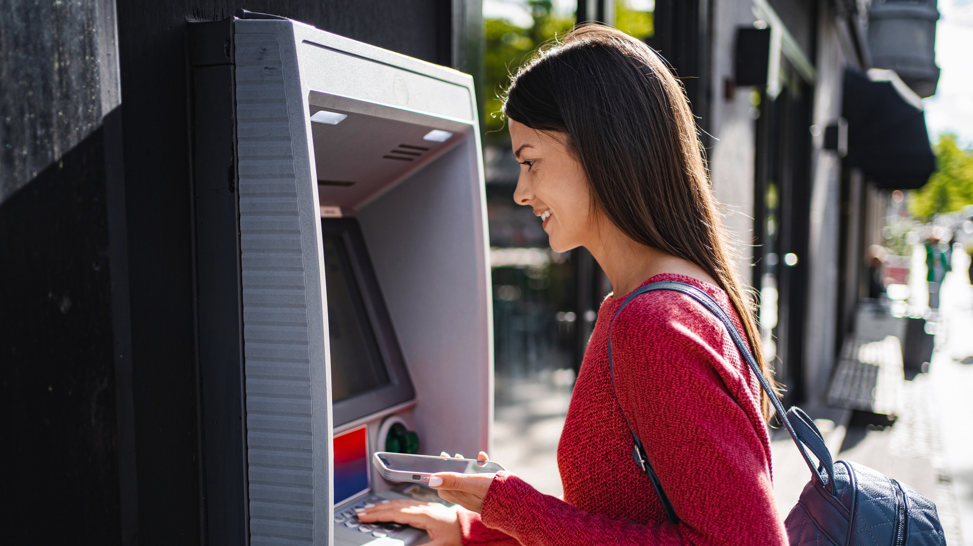
Presentation
Notes:
Ask students to think about and popcorn out examples of products and services offered by banks and credit unions they remember from their work in Lesson 5, Who is Who in the Financial System or from personal experience and write them down on the writing surface.

Slide 5
Bank and credit union services
Type | Products and Services | What They are Used For
Accounts | Checking, savings, and money market accounts; certificates of deposit | Safely storing money, managing daily finances, and earning interest
Payments | Debit cards, checks, online and mobile banking, bill pay, wire transfers | Making purchases, paying bills, and transferring money
Loans and credit | Personal loans, auto loans, mortgages, credit cards | Borrowing money for personal needs, large purchases, or emergencies
Investments | Retirement accounts, investment services | Saving and investing for long-term financial goals
Cash services | ATMs, cashier’s checks, money orders | Accessing cash and making secure payments
Business services | Business accounts, merchant services, business loans | Managing business finances and supporting business operations
Notes:
Review with students the information provided. Use the slide to cross-check and expand on the list of products and services the students brainstormed in the previous step.
Note for students that for many young people, a checking account and a savings account are their initial entry into the banking system, making them an appropriate focus before moving on to more advanced financial products and services. The rest of the lesson will thus shift to focus on the accounts most students are likely to encounter first.

Slide 6
Checking accounts
Used for everyday spending
Examples:
  Buying food
  Paying bills
  Using a debit card
Money goes in and out frequently
Notes:
Review with students the information provided.

Slide 7
Savings accounts
Used to save money over time
Usually earn interest
Best for:
  Emergency funds
  Short- or long-term goals
Notes:
Review with students the information provided. Share that banks and credit unions sometimes offer special accounts for youth and young adults offering higher interest rates to encourage the building of saving habits.

Slide 8
Checking or savings?
For each financial need, decide if a checking or savings account is more useful.
Options
Checking account
Savings account
Need | Which account?
Emergency fund
Car payment
New video game next month
Paycheck deposits
Daily spending money
Money for a summer vacation
Notes:
Review with students the instructions provided. Students will decide whether a checking or savings account is better for each financial need.
Read each financial need aloud and ask students to identify whether a checking account or savings account would be more useful. Ask them to show one or two fingers to indicate their choice. Record their responses on the writing surface.

Slide 9
Checking or savings? (Answers)
For each financial need, decide if a checking or savings account is more useful.
Options
Checking account
Savings account
Need | Which account?
Emergency fund | Savings account
Car payment | Checking account
New video game next month | Savings account
Paycheck deposits | Checking account
Daily spending money | Checking account
Money for a summer vacation | Savings account
Notes:
Review the suggested answers with students. Encourage students who have questions about or disagree with an answer to explain their reasoning. Emphasize that checking accounts are generally used for everyday spending, while savings accounts are designed for money that will be set aside for future goals. Many people use both checking and savings accounts together.

Slide 10
Key account terms
Deposit—Adding money to an account (paycheck, cash, transfers)
Withdrawal—Taking money out (cash, debit card purchases, payments)
Balance—How much money you currently have in an account
Fee—Money a bank or credit union charges for certain services
Overdraft—When the bank lets a payment go through even though you don’t have enough money, making your balance negative and often causing extra fees
Annual percentage yield (APY)—How much interest a savings account earns in one year, expressed as a percentage
Notes:
Review with students the information provided.
Present students with the following scenario.
Ask: You have $10 in your account. You try to spend $15. What do you think happens?
Invite a few students to share their ideas and record their responses on the writing surface. Then review the slide and explain that depending on the situation, the transaction may be declined, the account may be overdrawn, or a fee such as an overdraft or non-sufficient funds fee may be charged.

Slide 11
Understanding fees
Common banking fees include:
  Monthly maintenance fees
  ATM fees
  Overdraft/non-sufficient funds (NSF) fees
Can be avoided through maintaining minimum balances, banking online, and only spending money that is available in an account
Notes:
Review with students the information provided.

Slide 12
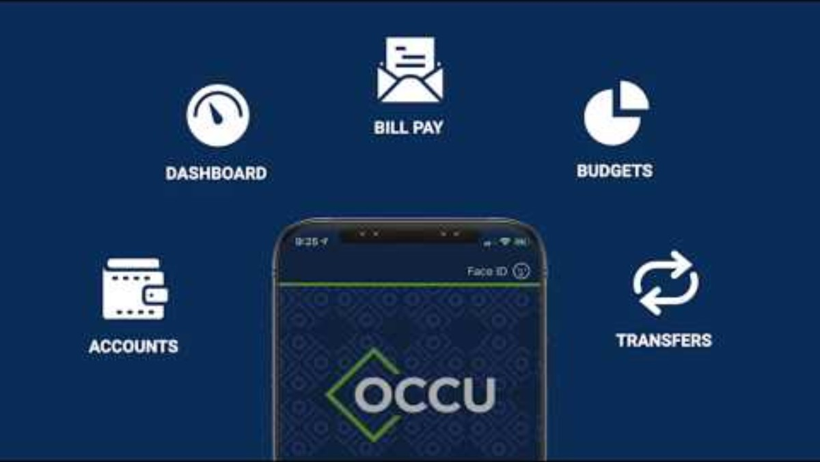
Checking your money online
Online and mobile banking allow you to:
Check balances in real time
See recent transactions
Track spending easily
Deposit a check using a phone
Set notifications and alerts
Image and video source: Oregon Community Credit Union (via YouTube), https://www.youtube.com/watch?v=EaY6D6Ollgc
Notes:
Review with students the information provided. Note that online and mobile banking help people manage their finances by giving them convenient, real‑time access to their bank or credit union accounts anytime and anywhere.
Play the digital banking demo video by clicking the image on the slide.
Transition to the application activity by explaining that students will now apply what they have learned by reviewing a sample bank or credit union account statement and identifying key details and transactions.

Slide 13

Break
Notes:
Optional break.

Slide 14

Application Activity
Notes:
Divide the class into small groups.

Slide 15
Activity instructions
Work with your group to review a sample bank or credit union account statement
Use the information in the statement to answer the questions
Be prepared to discuss your answers with the class
Notes:
Point students to the Sample Account Statement Analysis handout. Review the activity instructions as a class. Students will review a sample bank or credit union account statement and answer questions about it.
Invite groups to begin working on the activity.
Circulate among the groups as they work to answer questions and make sure they are staying on task.
After 15 minutes, or when it looks like students have completed their work, get their attention and move on to the activity debrief.

Slide 16

Debrief
Notes:
Using the Bank statement answer key slides (Slides 17-21), have students compare their work with answers provided on the slides. If students have questions about or disagree with any of the suggested answers, encourage them to explain their reasoning.

Slide 17
Bank statement answer key (1 of 5)
Getting Oriented
Statement Date: February 27, 2026
Total Accounts: 2
Account Types:
  Checking account
  Savings account

Slide 18
Bank statement answer key (2 of 5)
Account Summary Review
Beginning balance (checking): $131.74
Ending balance (checking): $180.14
Ending balance (savings): $1,342.60
Did the total balance increase or decrease?
  Increase
Why?
  Total balance increased from $1,462.19 to $1,522.74; increase of $60.55

Slide 19
Bank statement answer key (3 of 5)
Checking Account Activity
Debit card purchases: (Multiple; several answers possible)
Number of credits: 4
  01/30 Paycheck deposit $202.54
  02/01 Account transfer $50.00
  02/13 Paycheck deposit $156.83
  02/26 Account transfer $8.00
Largest withdrawal: $70; Internet transfer
Overdraft fee charged? No, total overdraft fees charged = $0

Slide 20
Bank statement answer key (4 of 5)
Savings Account Activity
Types of credits:
  Interest earned
  Deposit/Internet transfer (allowance)
Interest earned: $2.15
APY: 1.90 percent
Why is interest helpful?
  Money grows over time; savings increase automatically; small amounts can add up through compounding

Slide 21
Bank statement answer key (5 of 5)
Reflection
Why review your account statement?
  Track spending
  Find errors or fraud
  Know your available balance
  Avoid overdrafts
  Correct answer: All of the above

Slide 22
Good banking habits
Check account transactions regularly to catch mistakes, overspending, and fraud
Set low-balance alerts to avoid overdrafts and the resulting overdraft and NSF fees
Never share account numbers, passwords, or personal identification numbers (PINs)
Notes:
Review with students the information provided. Explain that with the practical knowledge students have gained from the lesson—specifically, reading bank statements and using accounts responsibly—they have a solid foundation for making informed financial decisions as their needs and responsibilities grow.
Take any questions from students before moving on.

Slide 23

Wrap-Up

Slide 24
Exit ticket
One thing I now understand better about managing a bank or credit union account is . . .
Notes:
Point students to the copy of the prompt on the slide that is provided on the last page of their handout packets. Invite students to write their responses to the prompt in their handouts in the spaces provided.

Slide 25

Thank you!
Notes:
Answer any final questions and thank students for their participation.

