Slide 1
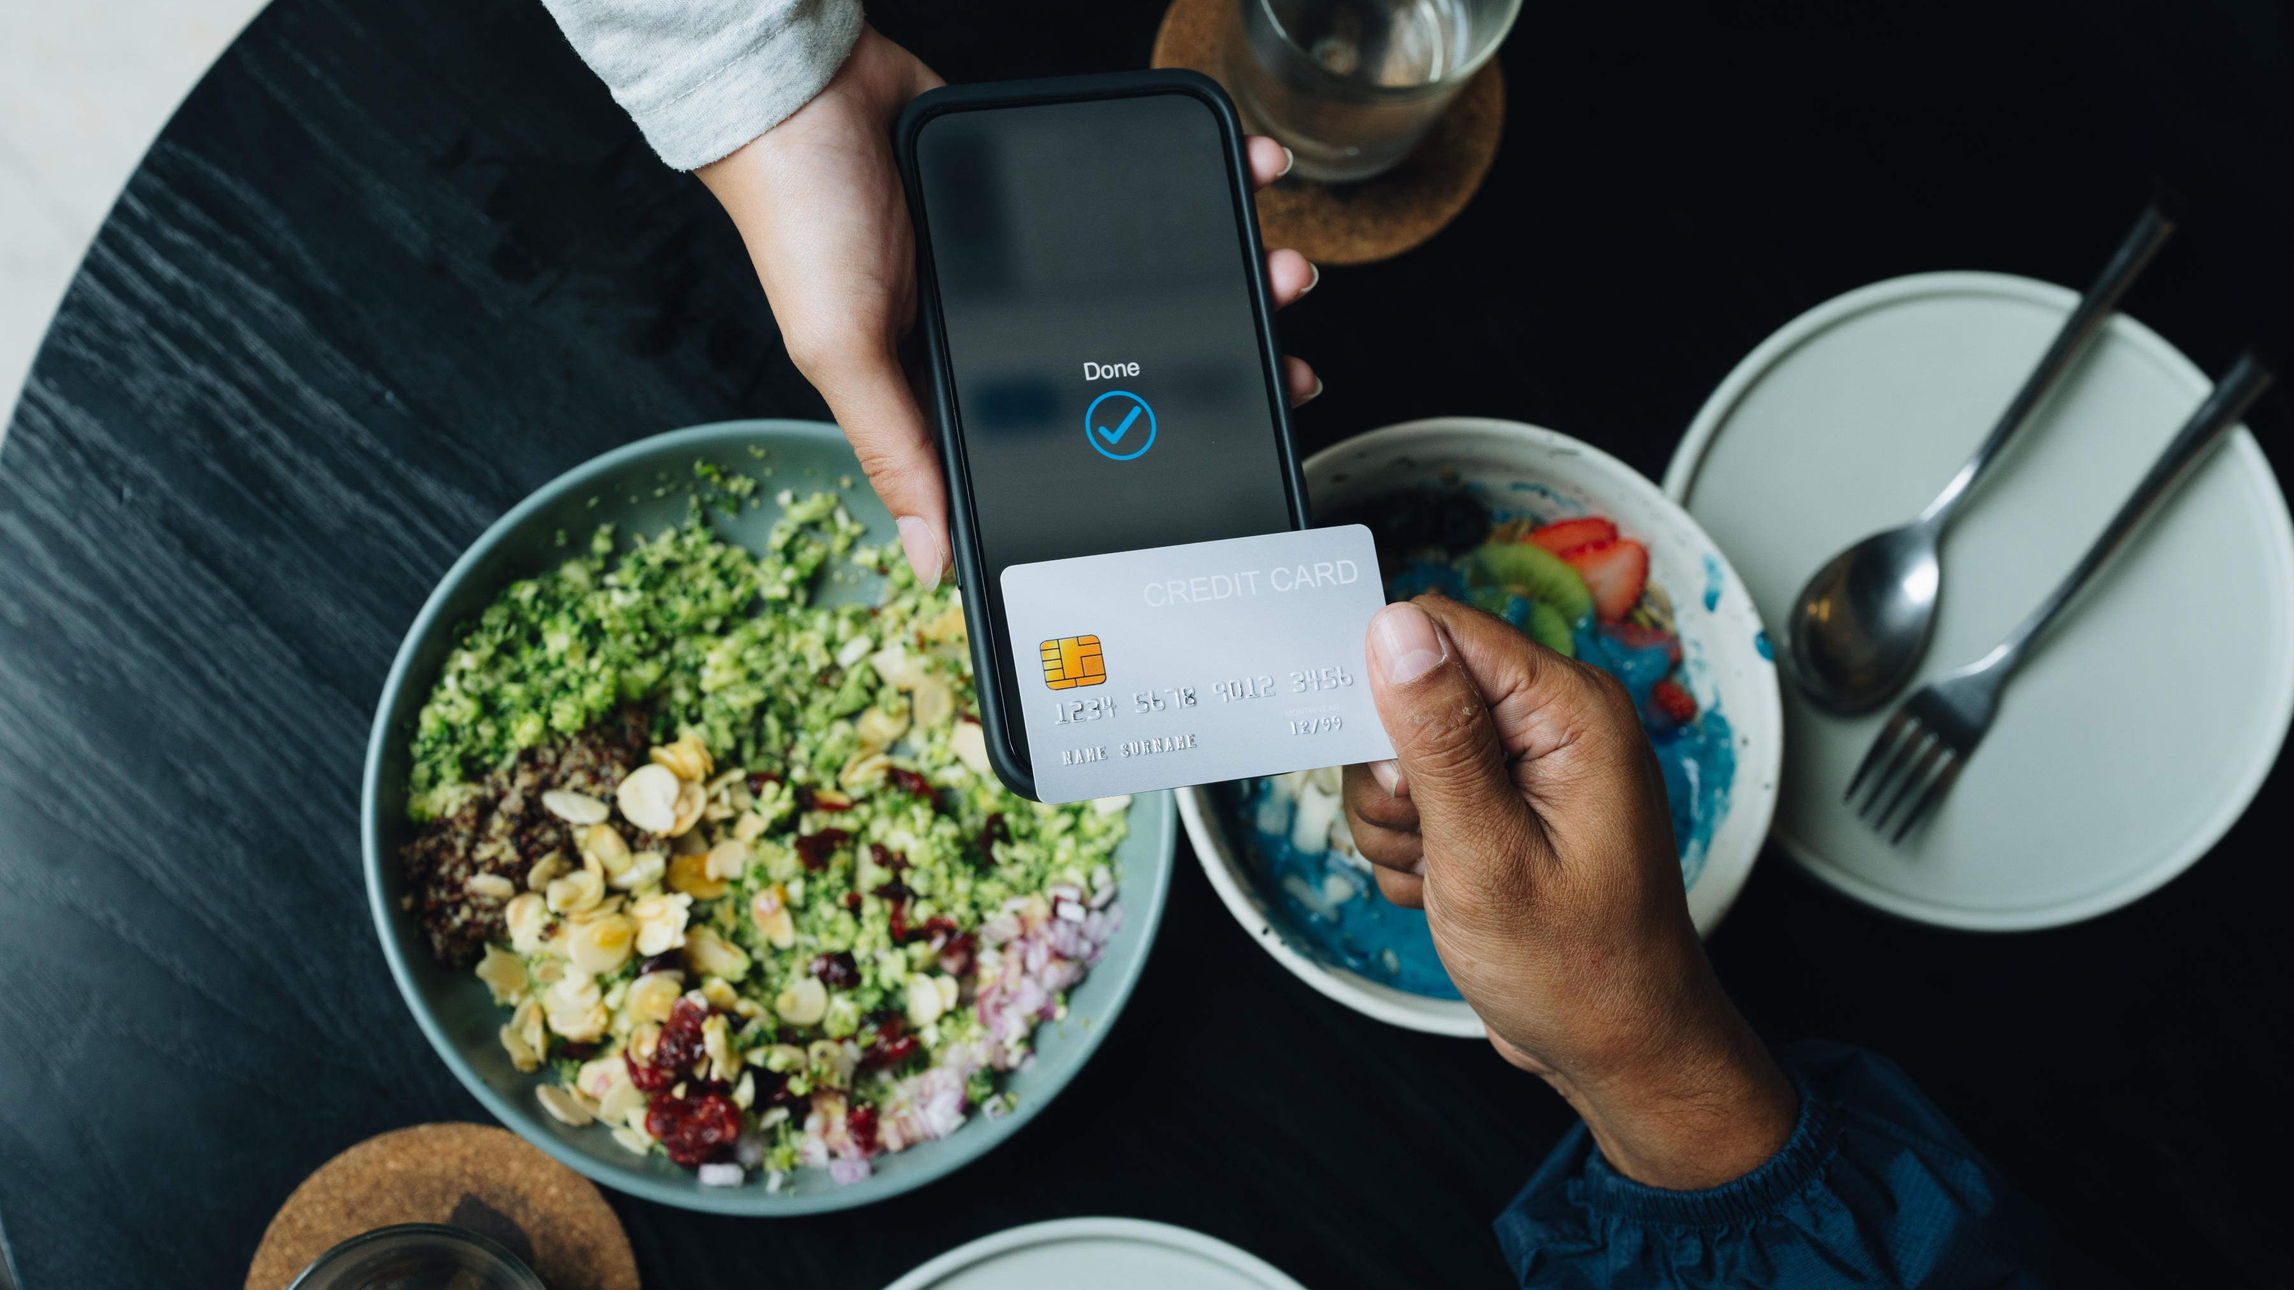
OnPoint Financial Literacy Education
Lesson 7: What is Credit?
Notes:
Distribute the handout packets to students, if you have not already.
[Sources]
Master layouts: Final_Revision 1_Slides_Lesson 1_Money and Me.pptx, NW Education SB 3 Lessons/Lesson 1 Money and Me.
Brand: OnPoint_Brand_Guidelines-COMPLETE_3-23-22-Bleed.pdf, NW Education SB 3 Lessons, pages 18, 27–31. Arial is the approved backup font and matches the reference deck.
[/Sources]

Slide 2
Warm-up
Where have you seen people use credit?
What words or phrases do you associate with credit?
What do you think credit is used for?
How can credit make people feel?
Notes:
Point students to the copy of the prompts on the slide (Where have you seen people use credit? What words or phrases do you associate with credit? What do you think credit is used for? How can credit make people feel?) that is provided on the first page of their handouts.
Invite students to take a moment to write down their responses to the prompts in the spaces provided in their handouts. Tell them there are no right or wrong answers—they should simply write whatever comes to mind.
Have students compare their lists with a partner. Ask them to sort their combined ideas into two categories: “things we are sure about” and “things we are unsure about.”
After a minute or two, invite a few groups to share one item from each category and record their responses on the writing surface.
Explain that credit can help people pay for major purchases, such as a home, car, or education, that they may not be able to afford right away. However, using credit irresponsibly can lead to debt and make it harder to achieve financial goals.
[Sources]
Master layouts: Final_Revision 1_Slides_Lesson 1_Money and Me.pptx, NW Education SB 3 Lessons/Lesson 1 Money and Me.
Brand: OnPoint_Brand_Guidelines-COMPLETE_3-23-22-Bleed.pdf, NW Education SB 3 Lessons, pages 18, 27–31. Arial is the approved backup font and matches the reference deck.
[/Sources]

Slide 3
Learning Targets
I can:
Identify different types of consumer credit
Compare the costs and benefits of different credit options
Notes:
Point students to the copy of the learning targets provided on the first page of their handouts. Review the learning targets with them.
Point students to the copy of the lesson glossary provided on the first page of their handouts and review the terms with them.
Point students to the Note Catcher handout and invite them to use it to take notes during the lesson.
[Sources]
Master layouts: Final_Revision 1_Slides_Lesson 1_Money and Me.pptx, NW Education SB 3 Lessons/Lesson 1 Money and Me.
Brand: OnPoint_Brand_Guidelines-COMPLETE_3-23-22-Bleed.pdf, NW Education SB 3 Lessons, pages 18, 27–31. Arial is the approved backup font and matches the reference deck.
[/Sources]

Slide 4

Presentation
Notes:
[Sources]
Master layouts: Final_Revision 1_Slides_Lesson 1_Money and Me.pptx, NW Education SB 3 Lessons/Lesson 1 Money and Me.
Brand: OnPoint_Brand_Guidelines-COMPLETE_3-23-22-Bleed.pdf, NW Education SB 3 Lessons, pages 18, 27–31. Arial is the approved backup font and matches the reference deck.
[/Sources]

Slide 5
What is credit?
Credit is the ability to buy now and pay later.
The lender may charge interest, which is like a “rental fee” for using borrowed money.
The word credit comes from the Latin word credere, which means “to trust,” “to believe,” or “to entrust.”
Notes:
Review with students the information provided.
Ask students to think of something people buy using credit. Take a few answers from students and write them on the writing surface.
[Sources]
Master layouts: Final_Revision 1_Slides_Lesson 1_Money and Me.pptx, NW Education SB 3 Lessons/Lesson 1 Money and Me.
Brand: OnPoint_Brand_Guidelines-COMPLETE_3-23-22-Bleed.pdf, NW Education SB 3 Lessons, pages 18, 27–31. Arial is the approved backup font and matches the reference deck.
[/Sources]

Slide 6
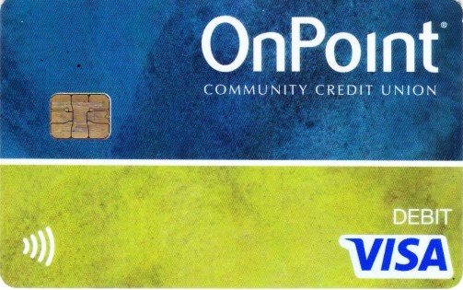
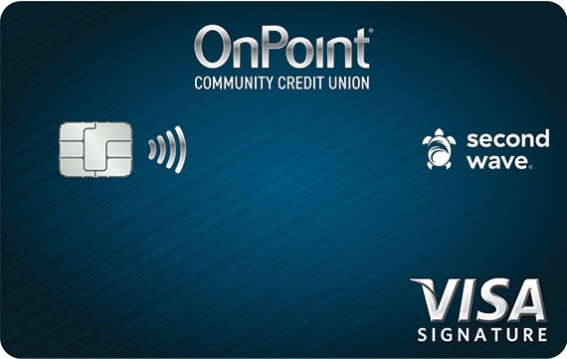
Credit concepts
Credit is using someone else’s money that you must return
Debit is using money you already have
Debt is the amount you owe when you borrow money
A loan is a specific amount of money that you borrow and repay over time, usually with interest.
Debit card
Credit card
Images source: OnPoint
Notes:
Review with students the terms provided.
[Sources]
Master layouts: Final_Revision 1_Slides_Lesson 1_Money and Me.pptx, NW Education SB 3 Lessons/Lesson 1 Money and Me.
Brand: OnPoint_Brand_Guidelines-COMPLETE_3-23-22-Bleed.pdf, NW Education SB 3 Lessons, pages 18, 27–31. Arial is the approved backup font and matches the reference deck.
[/Sources]

Slide 7
Common uses of credit
Credit card – Buy clothes, groceries, or pay for travel ✈️
Student loan – Borrow for college or vocational training 🎓
Financing – Make monthly payments for a car 🚗 or phone 📱
Mortgage (home loan) – Borrow to purchase a house 🏠
Notes:
Review with students the information provided.
Ask students which of the common types of credit they think most adults use. Take a few responses and write them on the writing surface.
[Sources]
Master layouts: Final_Revision 1_Slides_Lesson 1_Money and Me.pptx, NW Education SB 3 Lessons/Lesson 1 Money and Me.
Brand: OnPoint_Brand_Guidelines-COMPLETE_3-23-22-Bleed.pdf, NW Education SB 3 Lessons, pages 18, 27–31. Arial is the approved backup font and matches the reference deck.
[/Sources]

Slide 8
Credit key terms
Principal: A sum of money you borrow
Interest rate: The extra money paid for the use of money over time, usually expressed as a percentage
Annual percentage rate (APR): The cost of borrowing expressed as a yearly percentage, including interest and certain fees. It tells a borrower how much they will pay if they carry a balance on any type of credit
Notes:
Review with students the terms and definitions provided.
Use a simple example to explain the difference between an interest rate and annual percentage rate (APR).
Tell students that if they borrow $100 for one year at an interest rate of 10 percent, they would pay $10 in interest, for a total repayment of $110.
Explain that interest is the extra money paid for borrowing, similar to a rental fee for using someone else's money.
Point out that in this example, the APR is also 10 percent because there are no additional fees.
Explain that when loans or credit cards include fees, the APR is usually higher than the interest rate because it reflects the total yearly cost of borrowing.
[Sources]
Master layouts: Final_Revision 1_Slides_Lesson 1_Money and Me.pptx, NW Education SB 3 Lessons/Lesson 1 Money and Me.
Brand: OnPoint_Brand_Guidelines-COMPLETE_3-23-22-Bleed.pdf, NW Education SB 3 Lessons, pages 18, 27–31. Arial is the approved backup font and matches the reference deck.
[/Sources]

Slide 9
Two big questions about credit
Do you borrow once or borrow repeatedly?
Is collateral required?
Notes:
Review with students the information provided.
[Sources]
Master layouts: Final_Revision 1_Slides_Lesson 1_Money and Me.pptx, NW Education SB 3 Lessons/Lesson 1 Money and Me.
Brand: OnPoint_Brand_Guidelines-COMPLETE_3-23-22-Bleed.pdf, NW Education SB 3 Lessons, pages 18, 27–31. Arial is the approved backup font and matches the reference deck.
[/Sources]

Slide 10
Installment vs. revolving credit
Installment | Revolving
Borrow once | Borrow as needed
Fixed payments | Flexible payment
Car loan | Credit card
Student loan | Line of credit
Notes:
Review with students the information provided.
Ask students to think about which type of credit it is easier to overspend with and take a few responses.
Explain that revolving credit is easier to overspend with because people can continue borrowing, repaying, and borrowing again, which can make it harder to keep track of how much they owe.
[Sources]
Master layouts: Final_Revision 1_Slides_Lesson 1_Money and Me.pptx, NW Education SB 3 Lessons/Lesson 1 Money and Me.
Brand: OnPoint_Brand_Guidelines-COMPLETE_3-23-22-Bleed.pdf, NW Education SB 3 Lessons, pages 18, 27–31. Arial is the approved backup font and matches the reference deck.
[/Sources]

Slide 11
Secured vs. unsecured credit
Secured | Unsecured
Collateral required | No collateral
Lower risk for lender | Higher risk for lender
Car loan | Credit card
Mortgage | Personal loan
Notes:
Review with students the information provided.
[Sources]
Master layouts: Final_Revision 1_Slides_Lesson 1_Money and Me.pptx, NW Education SB 3 Lessons/Lesson 1 Money and Me.
Brand: OnPoint_Brand_Guidelines-COMPLETE_3-23-22-Bleed.pdf, NW Education SB 3 Lessons, pages 18, 27–31. Arial is the approved backup font and matches the reference deck.
[/Sources]

Slide 12
One product, multiple categories
Credit Product | Type
Car loan | Installment + Secured
Credit card | Revolving + Unsecured
Mortgage | Installment + Secured
Business line of credit | Revolving + Unsecured
Notes:
Review with students the information provided.
[Sources]
Master layouts: Final_Revision 1_Slides_Lesson 1_Money and Me.pptx, NW Education SB 3 Lessons/Lesson 1 Money and Me.
Brand: OnPoint_Brand_Guidelines-COMPLETE_3-23-22-Bleed.pdf, NW Education SB 3 Lessons, pages 18, 27–31. Arial is the approved backup font and matches the reference deck.
[/Sources]

Slide 13
Identifying credit types
Ask: Is it borrowed once or re-used?
  Borrowed once: installment loan
  Re-used: revolving loan
Ask: Is collateral required?
  Yes: secured loan
  No: unsecured loan
Notes:
Review with students the information provided. Encourage students to use the two questions posed on the slide (Is it borrowed once or re-used? and Is collateral required?) as a tool for identifying the credit types in the scenarios they will analyze during the following application activity.
Answer any questions from students before proceeding.
[Sources]
Master layouts: Final_Revision 1_Slides_Lesson 1_Money and Me.pptx, NW Education SB 3 Lessons/Lesson 1 Money and Me.
Brand: OnPoint_Brand_Guidelines-COMPLETE_3-23-22-Bleed.pdf, NW Education SB 3 Lessons, pages 18, 27–31. Arial is the approved backup font and matches the reference deck.
[/Sources]

Slide 14

Application Activity
Notes:
Divide the class into small groups.
[Sources]
Master layouts: Final_Revision 1_Slides_Lesson 1_Money and Me.pptx, NW Education SB 3 Lessons/Lesson 1 Money and Me.
Brand: OnPoint_Brand_Guidelines-COMPLETE_3-23-22-Bleed.pdf, NW Education SB 3 Lessons, pages 18, 27–31. Arial is the approved backup font and matches the reference deck.
[/Sources]

Slide 15
Activity instructions
Read each scenario with your group
Decide whether the credit is:
  Installment or revolving
  Secured or unsecured
Your group will be assigned one scenario to research. Find a similar credit offer from an Oregon bank, credit union, or retailer and record:
  APR or interest rate
  One fee
  One important feature
Be ready to share your answers with the class
Notes:
Point students to the Credit Scenarios handout. Review the activity instructions as a class. Students will work in small groups to analyze credit scenarios and identify the types of credit represented in each example as installment or revolving and secured or unsecured. Groups then research a real credit offer similar to an assigned scenario and record key information, such as the APR, fees, and product features.
Invite students to begin the first part of the activity (reviewing the four scenarios and determining which credit type is represented).
Circulate among the groups as they work to answer questions and make sure they are staying on task.
Once groups have completed the classification portion of the activity, assign each group one scenario to research.
Direct groups to go online and find a real credit product from an Oregon bank, credit union, or retailer that is similar to their assigned scenario and record the requested information in the table provided in the handout.
After 15 minutes, or when it looks like groups have completed their work, get their attention and move on to the activity debrief.
[Sources]
Master layouts: Final_Revision 1_Slides_Lesson 1_Money and Me.pptx, NW Education SB 3 Lessons/Lesson 1 Money and Me.
Brand: OnPoint_Brand_Guidelines-COMPLETE_3-23-22-Bleed.pdf, NW Education SB 3 Lessons, pages 18, 27–31. Arial is the approved backup font and matches the reference deck.
[/Sources]

Slide 16

Break
Notes:
Optional break.
[Sources]
Master layouts: Final_Revision 1_Slides_Lesson 1_Money and Me.pptx, NW Education SB 3 Lessons/Lesson 1 Money and Me.
Brand: OnPoint_Brand_Guidelines-COMPLETE_3-23-22-Bleed.pdf, NW Education SB 3 Lessons, pages 18, 27–31. Arial is the approved backup font and matches the reference deck.
[/Sources]

Slide 17

Debrief
Notes:
[Sources]
Master layouts: Final_Revision 1_Slides_Lesson 1_Money and Me.pptx, NW Education SB 3 Lessons/Lesson 1 Money and Me.
Brand: OnPoint_Brand_Guidelines-COMPLETE_3-23-22-Bleed.pdf, NW Education SB 3 Lessons, pages 18, 27–31. Arial is the approved backup font and matches the reference deck.
[/Sources]

Slide 18
Credit scenarios answer key
Scenario | Credit Types | Why?
Jordan buys a used car | Installment + secured | Borrows a fixed amount and makes monthly payments. The car is collateral.
Daniella finances furniture | Installment + unsecured | Borrows a fixed amount and makes monthly payments. No collateral is mentioned.
Mikaela uses a credit card | Revolving + unsecured | Can borrow, repay, and borrow again up to the credit limit. No collateral is required.
Ethan uses a business line of credit | Revolving + unsecured | Can borrow, repay, and borrow again as needed. No collateral is required.
Notes:
Have students compare their work with answers provided on the slide. If students have questions about or disagree with any of the suggested answers, encourage them to explain their reasoning and support their conclusions with evidence from their scenario.
Ask each group to briefly share the credit product they researched and the details they recorded for it.
Facilitate a brief discussion prompting students to notice similarities and differences they noticed between the different offers.
Ask students to consider which type of credit they think is most risky for young adults and why. Take responses from a handful of volunteers.
Share with students that revolving credit—especially credit cards—is often the riskiest type of credit for young adults because it is easy to get and usually has high interest rates (15 to 25 percent or higher). If the balance is not paid in full each month, the amount owed can grow quickly. Unsecured loans, like payday loans, can also be risky because their APRs can be extremely high (sometimes up to 300 percent).
Ask students to consider if they were lending money to someone what would make them trust them to pay them back. Have them briefly discuss their thoughts with a partner and then ask a few volunteers to share their thoughts with the class.
[Sources]
Master layouts: Final_Revision 1_Slides_Lesson 1_Money and Me.pptx, NW Education SB 3 Lessons/Lesson 1 Money and Me.
Brand: OnPoint_Brand_Guidelines-COMPLETE_3-23-22-Bleed.pdf, NW Education SB 3 Lessons, pages 18, 27–31. Arial is the approved backup font and matches the reference deck.
[/Sources]

Slide 19
Prime credit
Prime credit means a borrower has a strong history of paying bills and debts on time
People with prime credit often:
  Qualify for loans more easily
  Pay lower interest rates
  Have more credit options
Example: Two people apply for the same car loan. The person with prime credit may get a lower interest rate and pay less overall.
Notes:
Review with students the information provided.
Explain that prime credit refers to borrowers who have a strong history of paying bills and debts on time. Because lenders view them as lower risk, they are more likely to qualify for loans and credit cards with lower interest rates and better terms.
Emphasize that building good credit habits, such as making payments on time and borrowing responsibly, can help someone qualify for prime credit in the future.
Remind students how they learned about needs, wants, and obligations in Lesson 2, Managing Your Money. Explain that using credit should support their real needs and financial goals, not impulsive wants.
[Sources]
Master layouts: Final_Revision 1_Slides_Lesson 1_Money and Me.pptx, NW Education SB 3 Lessons/Lesson 1 Money and Me.
Brand: OnPoint_Brand_Guidelines-COMPLETE_3-23-22-Bleed.pdf, NW Education SB 3 Lessons, pages 18, 27–31. Arial is the approved backup font and matches the reference deck.
[/Sources]

Slide 20
Using credit wisely
Borrow only what you can realistically repay
Make at least the minimum payment on time, every time
Compare costs (interest rates and fees) before choosing a credit product
Notes:
Discuss with students the tips provided for safely using credit.
Emphasize that borrowing only what they can afford to repay, making payments on time, and comparing interest rates, APRs, and fees before borrowing can help them maximize the benefits of credit while reducing its risks.
Conclude by noting that good credit habits today can make it easier to qualify for better loan and credit card terms in the future.
[Sources]
Master layouts: Final_Revision 1_Slides_Lesson 1_Money and Me.pptx, NW Education SB 3 Lessons/Lesson 1 Money and Me.
Brand: OnPoint_Brand_Guidelines-COMPLETE_3-23-22-Bleed.pdf, NW Education SB 3 Lessons, pages 18, 27–31. Arial is the approved backup font and matches the reference deck.
[/Sources]

Slide 21

Wrap-Up
Notes:
[Sources]
Master layouts: Final_Revision 1_Slides_Lesson 1_Money and Me.pptx, NW Education SB 3 Lessons/Lesson 1 Money and Me.
Brand: OnPoint_Brand_Guidelines-COMPLETE_3-23-22-Bleed.pdf, NW Education SB 3 Lessons, pages 18, 27–31. Arial is the approved backup font and matches the reference deck.
[/Sources]

Slide 22
Exit ticket
What type of credit do you think you will use first?
What is one benefit of credit?
What is one risk of credit?
Notes:
Point students to the copy of the prompts on the slide that is provided on the last page of their handout packets. Invite students to write their responses to the prompts in their handouts in the spaces provided.
[Sources]
Master layouts: Final_Revision 1_Slides_Lesson 1_Money and Me.pptx, NW Education SB 3 Lessons/Lesson 1 Money and Me.
Brand: OnPoint_Brand_Guidelines-COMPLETE_3-23-22-Bleed.pdf, NW Education SB 3 Lessons, pages 18, 27–31. Arial is the approved backup font and matches the reference deck.
[/Sources]

Slide 23

Thank you!
Notes:
Answer any final questions and thank students for their participation.
[Sources]
Master layouts: Final_Revision 1_Slides_Lesson 1_Money and Me.pptx, NW Education SB 3 Lessons/Lesson 1 Money and Me.
Brand: OnPoint_Brand_Guidelines-COMPLETE_3-23-22-Bleed.pdf, NW Education SB 3 Lessons, pages 18, 27–31. Arial is the approved backup font and matches the reference deck.
[/Sources]

