Slide 1

OnPoint Financial Literacy Education
Lesson 8: Your Credit Story
Notes:
Distribute the handout packets to students, if you have not already.

Slide 2
Warm-up
Imagine you are a credit union that lends money to lots of people.
How would you decide who to lend money to?
Notes:
Point students to the copy of the prompt on the slide (Imagine you are a credit union that lends money to lots of people. How would you decide who to lend money to?) that is provided on the first page of their handouts.
Invite students to take a moment to write down their responses to the prompt in the space provided in their handouts. Tell them there are no right or wrong answers—they should simply write whatever comes to mind.
Have students turn to a partner and compare their answers.
Invite a handful of volunteers to share their answers with the whole class and write down what they share on the writing surface.
Remind students about the types of credit they learned about in Lesson 7, What is Credit? Banks and credit unions want to be sure they will be repaid when they lend money to people. They rely on credit reports and scores to decide if someone is a good credit risk. This lesson explains how credit reports and scores work and how borrowing decisions impact them.

Slide 3
Learning targets
I can:
Identify the main parts of a credit report
Explain what affects a person’s credit history and credit score and determine which choices help or hurt them
Notes:
Point students to the copy of the learning targets provided on the first page of their handouts. Review the learning targets with them.
Point students to the copy of the lesson glossary provided on the first page of their handouts and review the terms with them.
Point students to the Note Catcher handout and invite them to use it to take notes during the lesson.

Slide 4

Presentation

Slide 5
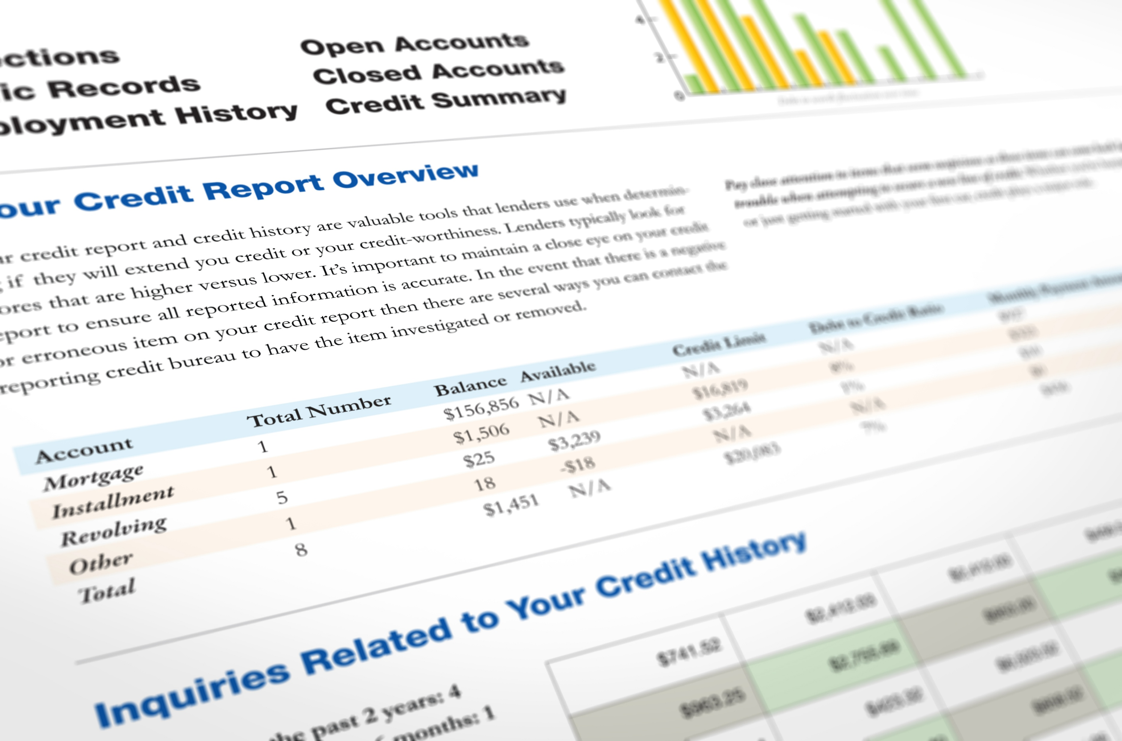
What is a credit report?
A record of borrowing and repayment history
It is like a “report card” of your money habits, showing how you have handled borrowing money, paying bills, and using credit
Notes:
Review with students the information provided.
Ask students the following question, taking and writing down a few responses on the writing surface.
Ask: If you were lending someone money, what information would you want to know about them first?
Explain that a credit report is one tool lenders use to learn about a person's borrowing and repayment history.

Slide 6

Where do credit reports come from?
Credit reports are created by three major companies called credit reporting agencies: Equifax, Experian, and TransUnion
These agencies collect and maintain information from banks, credit card companies, and other lenders about how people borrow money and pay their bills
Image source: AnnualCreditReport.com
Notes:
Review with students the information provided.

Slide 7

What is a credit score?
A three-digit number (300-850) that predicts how likely a person is to repay borrowed money on time
The score is based on information in credit reports and calculated by scoring companies such as Fair Isaac Corporation (FICO)
Each credit reporting agency may report a different score because they have different information
Notes:
Review with students the information provided.

Slide 8
What is a “good” credit score?
Each lender decides, but the following is a general guide to scores provided by FICO:
  Poor: 300-579; lenders consider borrowers with these scores risky
  Fair: 580-669; some lenders approve loans with these scores
  Good: 670-739; most lenders consider scores in this range good
  Very Good: 740-799; lenders consider these borrowers very dependable
  Exceptional: 800-850; borrowers with these scores get the best credit terms
Notes:
Review with students the information provided.

Slide 9
What affects your credit score?
Payment history (35 percent): Do you pay your bills on time?
Amounts owed (30 percent): How much have you borrowed?
Length of credit history (15 percent): How long have you been using credit?
Credit mix (10 percent): What types of credit are you using?
New credit (10 percent): Are you taking on more risk?
Notes:
Review with students the information provided.
Ask students to turn to a partner and discuss why paying bills on time and keeping balances low might be important to lenders. After 30-60 seconds, invite a few students to share their ideas. Emphasize that these factors help lenders evaluate responsibility and risk.

Slide 10
How are credit reports and scores used?
Credit reports and scores help lenders decide whether to approve loans or credit cards and what interest rate to offer
Landlords, employers, and utility companies may also check them for rentals, jobs, or services
A good score can save you money and create more financial opportunities
Notes:
Review with students the information provided.

Slide 11
Keep in mind
Most high school students have little or no credit history because you usually must be 18 to apply for credit
A credit score is like a GPA. It reflects your credit habits and can improve over time
Credit reports can contain mistakes, so check them regularly. You can get a free credit report from each credit bureau every year
Notes:
Review with students the information provided.

Slide 12
Ways to build and keep good credit
Pay bills on time: Use reminders or autopay to avoid late payments
Keep credit card balances low: Try to use less than 30% of your available credit
Pay more than the minimum payment: This helps you pay off debt faster and avoid extra interest
Build credit early and keep accounts open: Older accounts can help your credit score
Notes:
Review with students the information provided.

Slide 13
Ways to build and keep good credit (continued)
Only apply for credit when you need it: Applying too often can lower your credit score
Use different types of credit responsibly: Over time, having a mix of credit accounts can help your credit score
Notes:
Review with students the information provided.
Ask students the following question, taking and writing down a few responses on the writing surface.
Ask: What do you think someone should be able to do before getting a credit card?

Slide 14
When should I get a credit card?
You are at least 18 years old
You have income and can pay your credit card bill in full each month
You have a basic budget and understand your spending and saving
You understand how credit cards work, including interest rates and payments
You are ready to start building credit. Consider a secured credit card or becoming an authorized user on a trusted adult's credit card
Notes:
Review with students the information provided.
Note that obtaining a secured credit card or being added as an authorized user on someone else's credit card can be good ways for students to begin building a credit history once they turn 18.
Students can use the card for small, planned expenses such as a streaming subscription, gas, a transit pass, a cell phone bill, school supplies, or occasional grocery purchases.
Emphasize that they should only charge amounts they can afford to repay, keep balances low, and pay the full balance on time each month.
Consistent responsible use can help students establish a positive credit history and build a strong credit score over time.
Take any questions from students before proceeding.

Slide 15

Break
Notes:
Optional break.

Slide 16

Application Activity
Notes:
Divide the class into small groups.

Slide 17
Activity instructions
Work with your group to review the sample credit report, including the notes and tips provided
Use information from the credit report to answer the questions
Be ready to share your answers with the class
If directed by your teacher or instructor, complete one or more of the scenarios in the “Credit Score Scenarios” handout.
Notes:
Point students to the Sample Credit Report handout. Review the activity instructions as a class. Working in groups, students will review a sample credit report and accompanying notes, then work together to answer questions that help them identify and interpret key information from the report. Note for students that the report uses fake information and may look slightly different from real reports, but it shows the typical details found in an actual credit report.
Invite groups to begin working on the activity.
Circulate among the groups as they work to answer questions and make sure they are staying on task.
When it looks like all groups have completed their review of the mock credit report, and if time permits, have them move on to work on the scenarios activity in the Credit Score Scenarios handout. You can have each group work on all five of the scenarios or assign each group one scenario to work on. You may choose to re-display the What affects your credit score? slide (Slide 9) to help students complete the activity.
After an additional 5 minutes have passed, or when it looks like groups have completed their work on the credit score scenarios, get their attention and move on to the activity debrief.

Slide 18

Debrief
Notes:
Using the Sample credit report answer key slides (Slides 19-20), have students compare their work with answers provided on the slides. If students have questions about or disagree with any of the suggested answers, encourage them to explain their reasoning.
If students completed the Credit Score Scenarios activity, use the Credit score scenario answer key slides (Slides 21-25) to have students compare their answers to the suggested answers on the slide.
If groups were assigned different scenarios, invite a spokesperson from each group to briefly summarize their scenario and responses.
If all groups completed all scenarios, ask for volunteers to share their answers.
Students’ answers do not need to match the exact wording on the slides as long as they are conceptually or directionally correct.
Encourage students to explain their reasoning if their answers differ from the suggested responses and note that answers do not need to match the slide exactly to be correct.
Emphasize that good credit habits, such as paying on time, keeping balances low, and limiting unnecessary credit applications, can help build and maintain a strong credit score.

Slide 19
Sample credit report answer key (Questions 1-5)
Student loans are installment accounts
A bankruptcy can remain on a credit report for 7-10 years
Missed payments and collections appear in the Adverse Accounts section
Experts generally recommend keeping credit utilization below 30%
Hard inquiries can affect your credit score

Slide 20
Sample credit report answer key (Questions 6-10)
A Personal Consumer Statement can be used to dispute information or explain a financial hardship
Applying for several loans over a short period of time may lower your credit score because of multiple hard inquiries
A student loan paid on time is an example of a satisfactory account
A 30-day late payment may lower your credit score
A credit card application is an example of a hard inquiry

Slide 21
Credit score scenarios answer key (Scenario 1: Maria)
How do missed payments affect a credit score?
Missed payments can lower a credit score because payment history is the most important credit scoring factor
What can Maria do now?
Pay the overdue balance immediately
Set up automatic payments or reminders
Make future payments on time
Why is payment history important?
It shows lenders whether someone reliably repays debt

Slide 22
Credit score scenarios answer key (Scenario 2: James)
How do multiple credit applications affect a credit score?
Multiple hard inquiries can lower a credit score
Hard inquiry vs. soft inquiry
Hard inquiries occur when applying for credit and can affect a credit score
Soft inquiries do not affect a credit score
How can James build credit more responsibly?
Space out credit applications
Pay bills on time
Keep credit utilization low

Slide 23
Credit score scenarios answer key (Scenario 3: Sofia)
How does high credit utilization affect a credit score?
Using 90% of available credit can lower a credit score
What is a healthy credit utilization rate?
Below 30% is recommended
Below 10% is even better
How can Sofia improve her score?
Pay down balances
Avoid new charges
Consider increasing available credit

Slide 24
Credit score scenarios answer key (Scenario 4: Ethan)
How could closing an old account affect a credit score?
It may shorten credit history and increase credit utilization
Why does credit history matter?
A longer credit history shows experience managing credit responsibly
What could Ethan do instead?
Keep the account open
Use it occasionally for small purchases
Set up autopay for a recurring bill

Slide 25
Credit score scenarios answer key (Scenario 5: Lily)
Why might Lily receive higher interest rates?
She has experience with only one type of credit account
What types of credit make up a credit mix?
Revolving credit (credit cards)
Installment credit (auto loans, student loans, personal loans)
How can Lily improve her credit mix?
Responsibly manage more than one type of credit account over time

Slide 26

Wrap-Up

Slide 27
Exit ticket
One thing I learned today about credit reports or credit scores is __________.
One action that helps build a positive credit history is __________.
Understanding my credit report and credit score can help me __________.
Notes:
Point students to the copy of the prompts on the slide that is provided on the last page of their handout packets. Invite students to write their responses to the prompt in their handouts in the spaces provided.

Slide 28

Thank you!
Notes:
Answer any final questions and thank students for their participation.

